Slide 1
Virginia Association of School Business Officials
Community Eligibility Provision
Program Analysis, Viability, and Application
Virginia Department of Education
Office of School Nutrition Programs
November 5, 2019

Slide 2
BACKGROUND
Section 104(a) of the Healthy, Hunger-Free Kids Act of 2010 (Act) amended section 11(a)(1) of the Richard B. Russell National School Lunch Act to provide an alternative that eliminates the need for household applications for free and reduced-price meals in high-poverty LEAs and schools. This alternative, which is now part of the NSLP, is referred to as the Community Eligibility Provision (CEP).
CEP provides equitable access to school breakfast and school lunch for all students.

Slide 3
WHAT IS CEP?
Alternative to collecting meal applications
All enrolled students receive breakfast and lunch at no charge
Reimbursement:
No. identified students x 1.6 = % meals reimbursed at the free rate
Notes:
The Community Eligibility Provision is an alternate claiming method that allows schools and/or school divisions to provide breakfast and lunch meals at no cost to all enrolled students. In order to qualify, a school or division must have at least 40% of the enrolled students eligible for free meals by DIRECT CERTIFICATION ONLY. That’s not 40% free eligible, it’s 40% free by any method of direct certification as of April 1. The school and/or division claims a total number of meals served and receives reimbursement based on the Identified Student Percentage (ISP) – which is the number of students directly certified by any method as of April 1st using a multiplier, which is currently 1.6. The remainder is reimbursed at the paid rate.
If 62.5% of the students were directly certified as of April 1, that percentage is multiplied by 1.6 and 100% of the meals served would be paid at the free reimbursement rate.

Slide 4
TO BE ELIGIBLE
LEAs and/or Schools must:
Meet a minimum level of "identified students" for free meals in the year prior to implementing Community Eligibility;
Agree to serve free breakfasts and lunches to all students; and agree to cover with non-Federal funds any costs of providing free meals to students above the amounts provided by Federal assistance; and
Apply to VDOE by June 30, 2020 (federal guidance, no flexibility).
Reimbursement for each LEA or school is based on claiming percentages derived from the percentage of identified students, i.e., students certified for free meals through means other than individual household applications.

Slide 5
VIRGINIA CEP
2019-2020 Overview
New in 2019-2020
Accomack*
Alexandria
Amherst
Bristol*
Buchanan*
Church Hill Academy
Elijah House
Fauquier
Grayson
Newport News*
Northumberland*
Nottoway*
Park Place
Patrick*
Smyth*
Washington
SFAs: 74 (67 public/7 private)
Divisionwide CEP: 24 public
Schools: 511 (502 public/9 private)
Students: 241,056
* Divisionwide CEP

Slide 6
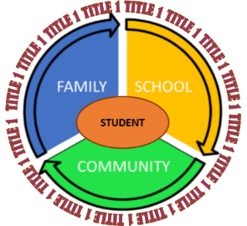
BENEFITS OF CEP
Students
Improved access to nutritious food
Parents
No paperwork or meal accounts
Admin
Streamlined meal service
School Staff
Reduced administrative burden
Notes:
Everyone benefits from CEP – students, parents, school staff and administrators:
Students have access to nutritious meals without stigma and spend less time in cashier lines.
Parents do not need to fill out a household application or worry about having money in their child’s meal account.
Our school staff benefit from a streamlined meal service operation with more time for students to consume their food.
Our nutrition administration will have less paperwork and administrative costs, no unpaid meal charges to track, and improved program integrity, participation and most likely revenue. This gives more time to focus on other needs.

Slide 7
HOW CEP WORKS
40% or more “Identified Students”
Certified through SNAP, TANF
Individual eligibility eliminated
One school in division must qualify
Can implement in any/all schools
Meals provided without applications
Notes:
Any school division can utilize CEP if at least one school in the division has 40% or more students eligible for free meals who are not subject to verification (called “Identified Students or ISP”). “Identified Students” includes students categorically eligible for free meals based on their participation in other specific means-tested programs, such as the Supplemental Nutrition Assistance Program (SNAP) and Temporary Assistance for Needy Families (TANF). Reimbursement is based on this ISP percentage.
As long as one school meets the requirements, the division may implement CEP in one school, a group of schools, or division-wide. Schools provide free breakfast and lunch to all students without collecting applications, completely eliminating individual eligibility.

Slide 8
DIRECT CERTIFICATION AND ISP
The identified student percentage is not the same as the total number of students eligible for free and reduced-price meals. Identified student counts only include the following:
Directly certified students and extension of direct certification benefits to other household members
Homeless students certified as such by the district liaison
Migrant youth certified by local officials
Runaway youth certified by local officials
Head Start students and
Foster children, certified based on documentation from the foster child case worker

Slide 9
VDOE STATEWIDE DC MATCH PROJECT
Currently - All school divisions are required to conduct DC match at least four times per year
New System - Fully operational January 2020
Direct Certification matching will be conducted by VDOE using data from the Virginia Department of Social Services (VDSS) and the local LEA.

Slide 10
Public Charge Rule
Legal Injunction blocked the October 15 change.
The INA (8 U.S.C. 1182) states that a person seeking admission to the United States or applying for adjustment of status is inadmissible if they are likely to become a public charge. In other words, decisions on immigration status are determined in part by whether a person will be primarily dependent on public programs for support. Effective October 15, 2019, the public charge determination criteria will be expanded to include whether an individual receives any number of public benefits, including Temporary Assistance for Needy Families (TANF), Supplemental Security Income, Supplemental Nutrition Assistance Programs (SNAP), state or local cash aid programs, Medicaid (with the exception of individuals 21 or younger)

Slide 11
Impact of the Public Charge Rule
What is the Public Charge Rule?
Impact on school nutrition
Impact on direct certification
Impact on meal debt
Impact on CEP
Notes:
From Dr. Lane’s Email:
Public Charge Rule
The INA (8 U.S.C. 1182) states that a person seeking admission to the United States or applying for adjustment of status is inadmissible if they are likely to become a public charge. In other words, decisions on immigration status are determined in part by whether a person will be primarily dependent on public programs for support. Effective October 15, 2019, the public charge determination criteria will be expanded to include whether an individual receives any number of public benefits, including Temporary Assistance for Needy Families (TANF), Supplemental Security Income, Supplemental Nutrition Assistance Programs (SNAP), state or local cash aid programs, Medicaid (with the exception of individuals 21 or younger), as well as Section 8 and federally-subsidized housing, for more than an aggregate of 12 months over any 36-month period. It is of note that these changes will not affect all immigrants, only those seeking admission to the United Stated or applying for adjustment of status. Lawful residents applying for citizenship are among the categories exempt from the amended rule. For more information on the INA, please refer to United States Citizenship and Immigration Services or the Immigrant Law Resource Center. The revised rule is also available in the Federal Register, Volume 84, page 41292.
These changes will undoubtedly affect some immigrant families’ access or willingness to participate in public benefit programs. As every families’ circumstance is unique, concerned individuals may want to seek legal advice. School personnel can also make these students and families aware of other available resources that would not compromise their public charge determination. Organizations might include local food banks, free health clinics, or those focused on affordable housing access.
Because of misinformation around changes to the Public Charge Rule, immigrant students may have been advised against or may be reluctant to take advantage of any public benefit, including those associated with public education. School personnel might observe changes in student behavior as they seek to avoid compromising their or their families’ public charge determination. Families might withdraw their children from school or students may begin missing school, avoid going to the doctor when ill, or forgo meal offerings. School personnel should inform students and families that public education is not among those services that affect admissibility. Students under the age of 21 are also still able to use Medicaid benefits for any health concerns without it weighing on their or their families’ immigration status.
Impact on School Nutrition Programs
Federal school nutrition and child nutrition meal program benefits are not considered public benefits under the public charge determination. These programs include the National School Lunch and School Breakfast Programs, Seamless Summer Option, Afterschool Meal Supplement, Special Milk Program, the At Risk portion of the Child and Adult Care Food Program, the Summer Food Service Program, and the Fresh Fruit and Vegetable Program. Student eligibility for school and child nutrition meal programs remain in effect throughout the eligibility period, which usually aligns with the school year. Therefore, students who have already qualified for school nutrition programs will not be impacted during this school year, independent of any change in the student’s qualifications for these programs, including withdrawal from SNAP, TANF, or Medicaid. In addition, school meal program eligibility has a 30 school day carry-over period into the next school year.
Effect on Direct Certification for School Nutrition Programs
Eligibility for free or reduced meals is determined by household application or by direct certification. In Virginia, a child is directly certified when he or she belongs to a household that participates in SNAP, TANF, or Medicaid. This information is provided to local school divisions from the qualifying agency (via VDOE) which then eliminates the need for local school divisions to collect household meal applications for those directly-certified families. Those families that have withdrawn from qualifying programs as the result of the Public Charge Rule will need to complete and return a household meal application for the upcoming school years, beginning in 2020-2021, prior to the expiration of the 30-school-day carryover period in order to be eligible for free or reduced school meals. Local school personnel are encouraged to assist families in this process. It is also of note that household meal applications are confidential under federal requirements.
Effect on Unpaid Meal Debt
Please note that the Public Charge Rule could potentially have an impact on unpaid student meal debt. If a student who is no longer eligible for direct certification in the new school year and has not submitted a household meal application were to continue to access the meal programs and accrue meal debt, the school division would be required to apply non-school nutrition program funds to cover this expense. Federal school nutrition program funds cannot be used to cover unpaid meal debt.
Effect on CEP Eligibility Thresholds
The Community Eligibility Provision (CEP) is a non-pricing meal service option for schools and school districts in low-income areas to serve school meals at no cost to all enrolled students without collection of household income applications. Eligibility for CEP participation is based on the percentage of students categorically eligible to receive direct certification from participation in a qualifying public benefit program. This figure is known as the Identified Student Percentage (or ISP). Schools currently participating in CEP can use the qualifying year ISP data for the duration of the four-year cycle and will not be impacted by any changes in the Public Charge Rule.
For the 2020-2021 school year, the ISPs calculated as of April 1, 2020 will be used to identify schools eligible for CEP for the 2020-2021 school year. New schools or renewing schools may be adversely impacted if students withdraw from qualifying benefit programs and the number of directly certified students decrease, lowering the ISP. A decrease in directly-certified students and ISP will also decrease federal reimbursements under the CEP program and increase the administrative burden to school divisions. School divisions will be responsible for the collection of those household meal applications that would have formerly been directly-certified students, the increased tracking of students by eligibility category, and the additional reporting and monitoring by both the state agency and local school division required for program compliance, including the verification process and benefit issuance monitoring.

Slide 12
MEAL COUNTING AND CLAIMING
The claiming percentages established in the first year for an LEA or school may be used for four school years and increased if the percentage of identified students rises for the LEA or school.
Requires schools to offer breakfast and lunch
Count and claim meals without the normal free and reduced application process
Schools that participate in CEP will no longer be required to collect Free and Reduced Price School Meals Family Applications to determine student eligibility for free meals.
Meals will still need to be counted at the Point of Service (POS), but just total meals, not meals by category.
Meal Counting and Claiming is a performance standard as part of the Federal Program Administrative Review.

Slide 13
Title 1 and E-Rate Resources
VDOE guidance and technical assistance:
Title 1 Coordinator
Director of Program Administration and Accountability
USDA guidance: https://www.fns.usda.gov/nslp/community-eligibility-provision-resource-center
Notes:
Title 1 requirements are successfully implemented in divisions across Virginia and the nation when CEP is elected….

Slide 14
Application and Notification
Determine Identified Student Percentage (ISP)
Complete financial analysis to determine viability
Submit application to VDOE
Once approved, the CEP application is good for 4 years
Notify families that meals are served at no cost
Notes:
To be eligible a division must qualify for CEP at one school. In the following slides, we’ll review our financial analysis. If we elect to move forward, the
CEP application must be submitted to the Virginia Department of Education Office (VDOE) of School Nutrition by June 30. Upon application, we will submit supporting documentation to our VDOE Regional Specialist to validate the ISP and claiming percentage. Once approved, the validated claiming percentage is good for 4 years. We would then notify families at schools implementing CEP that meals will be served at no cost or burden to them.

Slide 15
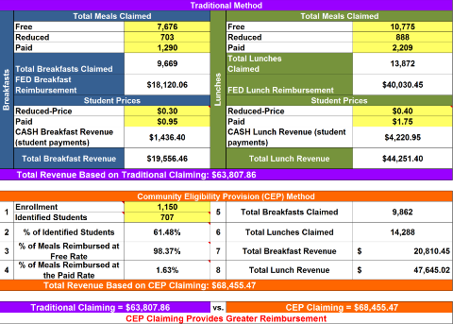
CEP Financial Analysis
Notes:
The USDA CEP Monthly Federal Reimbursement Estimator was used to analyze the financial viability of the school nutrition programs if CEP is implemented. The estimator can be found here: https://www.doe.in.gov/sites/default/files/.../copy-cep-estimator-worksheet-sy-1516.xls. Paid reimbursement .32 or .34 + 7 cents for certification
This doesn’t account for growth in participation, which is almost always greatest in the paid category. Nor cost savings from decreased admin burden.

Slide 16
Reimbursement Comparison
Traditional
CEP
Total Breakfast Revenue | $19,556.46
Total Lunch Revenue | $44,251.40
Total Revenue | $63,807.86
Total Breakfast Revenue | $20,810.45
Total Lunch Revenue | $47,645.02
Total Revenue | $68,455.47
Total Difference = $4,647.61
Notes:
[Provide a comparison of current monthly federal reimbursement and student payment revenue from the Optional Comparison table in the estimator]
When we look at the revenue difference between our current monthly Federal reimbursements and student payment revenue for lunch and breakfast, and the estimated CEP reimbursement, the numbers are again favorable with a total difference of [insert total reimbursement difference].
These estimates show a positive impact to our bottom line. The extra revenue received will help us make program improvements such as [insert goals and program improvements such as menu quality, equipment replacement, staffing, etc.]

Slide 17
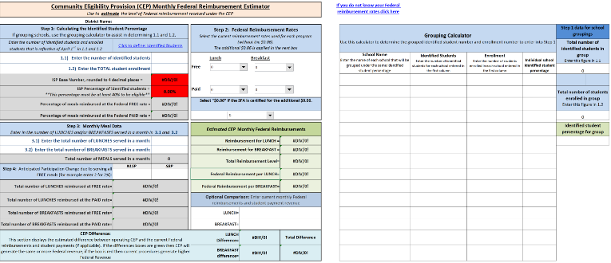
USDA ASSESSMENT TOOL
Notes:
The USDA CEP Monthly Federal Reimbursement Estimator was used to analyze the financial viability of the school nutrition programs if CEP is implemented. The estimator can be found here: https://www.doe.in.gov/sites/default/files/.../copy-cep-estimator-worksheet-sy-1516.xls

Slide 18
TIMELINE
Start now.
Look at this year’s Identified Student Percentage (ISP).
Consider your division profile (i.e. enrollment, community, significant change, etc.).
Use tools now with last year’s data to get an idea of whether CEP is feasible.
Set priorities.
Request assistance from VDOE Regional Specialists.
After April 1 ISP data is available, repeat calculations with the new data.

Slide 19
SUMMARY
You must evaluate CEP from a fiscal and programmatic perspective.
Is your division providing equitable meal access to all children?
Have you gauged your community’s interest?
Have you used available resources?

Slide 20
THANK YOU
Sandy Curwood, PhD, RDN
Director, Office of School Nutrition Programs
Virginia Department of Education
Sandra.Curwood@doe.virginia.gov
(804) 225-2074

