Slide 1
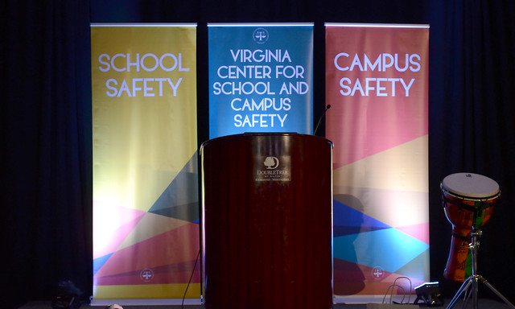
VASBO Conference
Virginia Center for School and Campus Safety
November 5, 2019

Slide 2
DCJS Virginia Center for
School and Campus Safety
Start with the Facts:
School is One of the Safest Places
for an American Child

Slide 3
Successful Safe School Programs
1
2
Legislation
Relationships
3
4
5
Strong school - law enforcement partnership
Data Collection
Positive School Climate

Slide 4
Building Block #1
Legislation

Slide 5

Virginia is for…
LEGISLATION

Slide 6
Legislation
1999 – Columbine
2000
Established the Virginia Center for School Safety (Virginia Code § 9.1-184)
Placed at DCJS
Provide services to K-12 public schools

Slide 7
Legislation
Center is responsible for:
  K-12
  Providing training for all school personnel
  Serving as a resource and referral center and providing technical assistance for Virginia school divisions
  Facilitating the annual school safety audit pursuant to Virginia Code § 22.1-279.8
  Maintaining and disseminating information to local school divisions on effective school safety initiatives in Virginia and across the nation
  Encouraging development of partnerships to promote school safety in Virginia
Notes:
§ 9.1-184
Virginia Center for School Safety
A. From such funds as may be appropriated, the Virginia Center for School Safety (the Center) is hereby established within the Department. The Center shall:
Provide training for Virginia public school personnel in school safety, on evidence-based antibullying tactics, and in the effective identification of students who may be at risk for violent behavior and in need of special services or assistance;
Serve as a resource and referral center for Virginia school divisions by conducting research, sponsoring workshops, and providing information regarding current school safety concerns, such as conflict management and peer mediation, bullying, school facility design and technology, current state and federal statutory and regulatory school safety requirements, and legal and constitutional issues regarding school safety and individual rights;
Maintain and disseminate information to local school divisions on effective school safety initiatives in Virginia and across the nation
Collect, analyze, and disseminate various Virginia school safety data, including school safety audit information submitted to it pursuant to § 22.1-279.8, collected by the Department;
Encourage the development of partnerships between the public and private sectors to promote school safety in Virginia;
6. Provide technical assistance to Virginia school divisions in the development and implementation of initiatives promoting school safety;
Develop a memorandum of understanding between the Director of the Department of Criminal Justice Services and the Superintendent of Public Instruction to ensure collaboration and coordination of roles and responsibilities in areas of mutual concern, such as school safety audits and crime prevention; and
Provide training for and certification of school security officers, as defined in § 9.1-101 and consistent with § 9.1-110.
B. All agencies of the Commonwealth shall cooperate with the Center and, upon request, assist the Center in the performance of its duties and responsibilities.

Slide 8
Legislation
2004 – School Safety Audits
2004, 2006 – School and Campus Security Officer Training and Certification
2008 – Higher Education Threat Assessment Teams
2013 – School and Campus Safety Task Force
  Renamed the Virginia Center for School and Campus Safety
  K-12 Threat Assessment Teams
  Critical Incident Response Curriculum
  Emergency Managers
  Model Policies and Procedures
  Lockdown Drills
Notes:
§ 9.1-184
Virginia Center for School Safety
A. From such funds as may be appropriated, the Virginia Center for School Safety (the Center) is hereby established within the Department. The Center shall:
Provide training for Virginia public school personnel in school safety, on evidence-based antibullying tactics, and in the effective identification of students who may be at risk for violent behavior and in need of special services or assistance;
Serve as a resource and referral center for Virginia school divisions by conducting research, sponsoring workshops, and providing information regarding current school safety concerns, such as conflict management and peer mediation, bullying, school facility design and technology, current state and federal statutory and regulatory school safety requirements, and legal and constitutional issues regarding school safety and individual rights;
Maintain and disseminate information to local school divisions on effective school safety initiatives in Virginia and across the nation
Collect, analyze, and disseminate various Virginia school safety data, including school safety audit information submitted to it pursuant to § 22.1-279.8, collected by the Department;
Encourage the development of partnerships between the public and private sectors to promote school safety in Virginia;
6. Provide technical assistance to Virginia school divisions in the development and implementation of initiatives promoting school safety;
Develop a memorandum of understanding between the Director of the Department of Criminal Justice Services and the Superintendent of Public Instruction to ensure collaboration and coordination of roles and responsibilities in areas of mutual concern, such as school safety audits and crime prevention; and
Provide training for and certification of school security officers, as defined in § 9.1-101 and consistent with § 9.1-110.
B. All agencies of the Commonwealth shall cooperate with the Center and, upon request, assist the Center in the performance of its duties and responsibilities.

Slide 9
Threat Assessment
Virginia law (§ 22.1-79.4) requires school boards to adopt policies for:
  Establishment of school TATs, for the assessment of and intervention with individuals whose behavior may pose a threat to the safety of school staff or students,
  consistent with the model policies developed by the Center,
  include procedures for referrals to CSBs and health providers.

Slide 10
Threat Assessment
Provide guidance on recognizing threatening/aberrant behavior that may represent a threat to the community, school, or self;
Identify members of the school community to whom threats should be reported;
Implement policies adopted by the school board for threat assessment;
Report data to the Center.

Slide 11
Legislation
2018–Oh my!! The year of School Safety
House Select Committee on School Safety
– 58 recommendations
Governor’s Workgroup of Student Safety
– 20 recommendations
Federal Commission on School Safety
– 95 recommendations

Slide 12
Legislation
First responders and others from specific groups must be included in crisis planning (HB1737)
Develop a mandatory model memorandum of understanding (HB1733 and SB1214)
Mandates SRO certification and trainings standards (July 2020)

Slide 13
Legislation
Mandates at least one school administrator must complete school safety training from the Center (HB2609/SB1130)
Design, develop, and implement an electronic threat assessment case management tool (HB1734/SB1213)
Development of an information sharing guide between schools and law enforcement (SB1591)

Slide 14
Building Block #2
Relationships

Slide 15


Slide 16
Virginia Center for
School and Campus Safety
132 public school superintendents
2,200 school administrators
4,500 assistant school administrators
120,000 teachers and school staff
69 colleges and universities
42 campus law enforcement agencies
367 law enforcement agencies
23,000 law enforcement officers
780 school resource officers
1,200 school security officers
600 campus security officers

Slide 17
Relationships
Cabinet level secretariats – Office of the Secretary of Education, Public Safety, and Health and Human Services
Other state agencies – Departments of Education, Behavioral Health (mental health services), Office of the Attorney General, state police, etc.
Front line stakeholders – law enforcement, school divisions, community service boards, counselor associations, educational associations
Federal agencies such as USDOE and REMS
Other state school safety leaders
Not for Profit Agencies such as Safe and Sound Schools and Koshka
Notes:
The SRO Grant Program and Fund is one of the most, if not the most, successful grant program initiated at DCJS. Grant programs often fade out when the grant money ends however SRO program which began with seed money in the 1990s are still going strong and being funded not only by law enforcement agencies but also with funding from local school divisions.
We have gone from school divisions that may once have said, no law enforcement in my schools to schools that do not want to operate without them,

Slide 18
Building Block #3
Strong school - law enforcement partnership

Slide 19
Legislation
SROs in Virginia schools in mid 1980s
DCJS began funding SROS through Byrne funding in
mid 1990s and offering SRO training
Provide services to K-12 public schools
Notes:
Currently there are 584 schools with Fulltime and 463 schools with part time SROs for a total of 1040 schools with SROs operating in Virginia schools. This represents about 53% of all Virginia schools (1956)

Slide 20
Legislation
§ 9.1-101 defines a School Resource Officer:
  A certified law-enforcement officer
  Hired by local law-enforcement agency
  Provides law-enforcement and security services to public elementary and secondary schools
  Police Departments and Sheriff’s Offices can place any officer in a school as they deem appropriate
  There is not a separate certification for SROs
Notes:
The SRO Grant Program and Fund is one of the most, if not the most, successful grant program initiated at DCJS. Grant programs often fade out when the grant money ends however SRO program which began with seed money in the 1990s are still going strong and being funded not only by law enforcement agencies but also with funding from local school divisions.
We have gone from school divisions that may once have said, no law enforcement in my schools to schools that do not want to operate without them,

Slide 21
Legislation
§ 9.1-101 defines a School Security Officer:
  Employed by local school board
  Maintains order and discipline, prevents crime, investigates violations of school board policies
  Detains students violating the law or school board policies on school property or at school-sponsored events
  Ensures safety, security, and welfare of school students, faculty, staff and visitors
Notes:
Virginia has 370 schools with either fulltime or parttime SSOs.
In approximately 27 school divisions

Slide 22
Legislation
1956 Virginia Schools
SROs in 86% of all middle and high schools
SROs in 34% of all elementary schools
Prior to legislation for SRO certification, Center trained approximately 85% of all SROs.
Notes:
Virginia has 370 schools with either fulltime or parttime SSOs.
In approximately 27 school divisions

Slide 23
Legislation
SROs are a vital link between the schools and community and can provide valuable resources
LEOs/SROs are intimately familiar with the ECO and CPS processes
LEOs/SROs are experienced in dealing with youth in crisis and can be a stabilizing influence

Slide 24

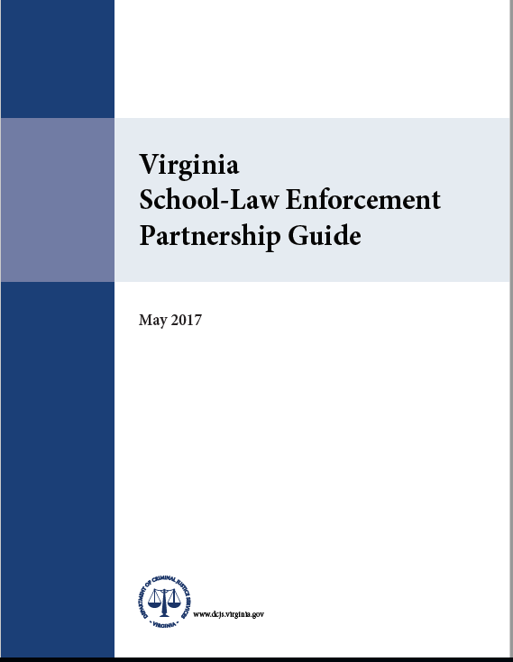
MOU and Partnership Guide

Slide 25
Building Block #4
Data Collection
Measure to Manage

Slide 26

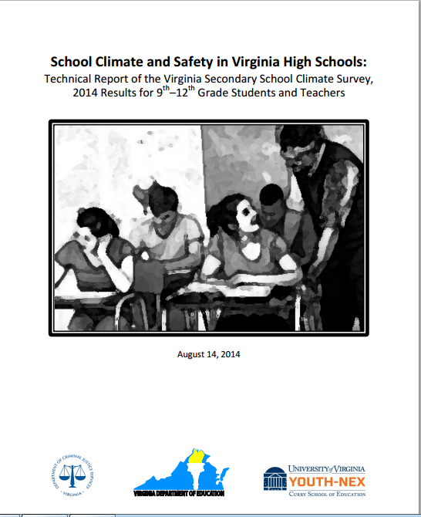
Data Collection
Annual Safety Audit Process

Slide 27
Data Collection
    Center is mandated to:
    collect, analyze, and disseminate various Virginia school safety data, (§ 22.1-279.8),
    collect quantitative data from threat assessment teams (§ 22.1-79.4. E)

Slide 28
Data Collection
Safety Audit
  “a written assessment of the safety conditions in each public school to
    (i) identify and if necessary, develop solutions for physical safety concerns, including building security issues and
    (ii) identify and evaluate any patterns of student safety concerns occurring on school property or at school sponsored events.
Audit data provides picture of school safety in Virginia
Drives best practices and improve school safety for school administrators and first responders

Slide 29
Data Collection
Virginia School Safety Survey (completed online annually)
Division Level Survey
Virginia School Crisis Management Plan Review and Certification (annually by August 31)
Virginia Secondary School Climate Survey
School Safety Inspection Checklist Certification

Slide 30
Threat Assessment Data
Collected annually via the Virginia School Safety Survey conducted by VCSCS at DCJS
2004–2005 through 2018-2019

Slide 31
Threat Assessment Data
Types of threat assessment (TA) data collected:
  TA teams (membership, expertise, frequency of meetings, training, etc.)
  TA records (storage of TA records)
  Threat reporting methods
  TA training/information for school staff
  Number/types of TAs conducted
  Case data

Slide 32
Threat Assessment Data
Number of threats (2017-2018)
1,563 schools (80%) reported conducting one or more threat assessments for a total of 14,869 threat assessments conducted in 2017-2018

Slide 33
Threat Assessment Data
Number of threats (2018-2019)
1,539 schools (78%) reported conducting one or more threat assessments for a total of 16,573 threat assessments conducted in 2018-2019

Slide 34
Number of Threat Assessments
School year | Number of schools | Number of schools reported 1 or > TA | Percent of schools reported 1 or > TA | Number of TAs reported
2004 – 05 | 1409* | 598 | 42.4% | 3500
2005 – 06 | 1988 | 602 | 30.3% | 3336
2006 – 07 | 1974* | 613 | 31.1% | 2926
2007 – 08 | 2002 | 754 | 37.7% | 2438
08 – 09 through 12 – 13 question was not asked
2013 – 14 | 1972 | 1157 | 58.7% | 5713
2014 – 15 | 1960 | 1068 | 54.5% | 5622
2015 – 16 | 1961 | 1234 | 62.9% | 7298
2016 – 17 | 1956 | 1285 | 65.7% | 9238
2017 – 18 | 1956 | 1563 | 79.9% | 14869
2018 - 19 | 1961 | 1539 | 78.4% | 16573
Notes:
5. This table shows both pre-mandate and post-mandate data.
In the early years of the survey, we asked schools for the number of threat assessments they conducted. The percent of schools that conducted one or more TAs in a given school year ranged between 30 and 42 percent.
Then we quit asking this question for awhile, and started asking it again after TA was mandated.
In the years since the mandate, the percentage of schools that reported conducting one or more TAs during the school year ranged from around 54% to around 80%.
Note the almost consistent climb in the numbers since the mandate.
It is unknown whether the increases reflect the school’s increasing familiarity with the TA process, or if the increases reflect an actual increase in the number of threats being made. Or both.
We need to better understand the factors that individual schools use to decide to conduct a threat assessment. What is their threshold, or triggering factor?
(ADD? From DMs slides 73-74 ) 1,563 schools (80%) reported conducting one or more threat assessments for a total of 14,869 threat assessments conducted in 2017-2018.
Data shows an increase in the number of schools reporting threats and the number of threats reported when compared to the previous school year.
In 2016-2017, 1,285 schools (66%) reported conducting one or more threat assessments, for a total of 9,238 threat assessments conducted.

Slide 35
Type of threat
 | 2015–2016 | 2016–2017 | 2017–2018 | 2018-2019
Against self | 42.4% | 49.4% | 55.7% | 60.5%
Against others | 52.8% | 45.2% | 38.9% | 34.7%
Against both | 5.8% | 5.4% | 5.2% | 4.8%
Notes:
11.
This table displays the percentages for each type of threat from all threat assessments conducted in a given school year.
Threats against others AND self (titled “both” in the table) remained steady during the 3 year period (between 5 – 6% of all threats)
Threats against others decreased over the three-year period, while threats against self increased during the same period.
Again, a qualitative study of the threat assessment process in the schools might shed some light on why these increases and decreases have occurred. There may be some changes in the models or processes used by the schools that are giving greater emphasis to assessing threats of self-harm.

Slide 36
Threat Data
“all threats” through “HLT events that occurred”
 | 2015–2016 | 2016–2017 | 2017–2018 | 2018-2019
# of all TAs conducted | 7298 | 9238 | 14890 | 16545
# TAs deemed HLTs | 657 | 928 | 1472 | 1169
% all TAs that were HLTs | 9% | 10% | 10% | 7%
# HLTs carried out | 42 | 40 | 42 | 38
% of HLTs carried out | 6% | 4% | 3% | 3%
% of all TAs that were HLTs carried out | 0.6% | 0.4% | 0.3% | 0.2%
Notes:
13. This table displays the threat assessment data for each of the 3 most recent school years.
- The first row of data (after the header row at the top of the table) shows the number of all threat assessments conducted by the schools
- The second and third rows show the number and percentage of TAs conducted that were classified at the highest level risk
- The fourth and fifth rows show the number and percentage of highest-level threats in which the threatened act was carried out
- And the bottom shows the percentage of ALL threats assessed that resulted in a high-level threat being carried out.
As you can see, the percentage of threats assessed that result in a high-level threat being carried out is very small – about one-half of one percent or fewer each year.
From DMs slide 86:
How many of those cases were ultimately averted (did not occur).
There were 1,472 highest level threats (HLTs) assessed among 514 schools statewide.
Most of these threats (1,430, 97%) were ultimately averted
added from DMs slide 87
Summary:
14,568 threat assessment cases involving current students in 2017–2018
1,472 (10%) were classified as a highest level threat by 514 schools,
42 (3%) resulted in an act being carried out at 28 schools.
Overall, 0.3% (less than 1%) of threats made by current students resulted in a highest level threat being carried out at 1.4% of the schools.

Slide 37
Building Block #5
Positive School Climate

Slide 38
Positive School Climate
“School climate is a broad, multifaceted concept that involves many aspects of the student’s educational experience. A positive school climate is the product of a school’s attention to fostering safety; promoting a supportive academic, disciplinary, and physical environment; and encouraging and maintaining respectful, trusting, and caring relationships throughout the school community no matter the setting—from Pre-K/Elementary School to higher education.”
(National Center on Safe Supportive Learning Environments)

Slide 39
Positive School Climate
  Climate Survey – Student Results
79% reported that they feel safe in their school
78% reported students are treated fairly regardless of their race or ethnicity
89% reported teachers care about all students
94% reported that there was at least one teacher at their school who really wants them to do well
75% said there was an adult at school they could talk with if they had a personal problem
77% are proud to be a student at their school and feel like they belong

Slide 40
Positive School Climate
Climate Survey – Staff Results
  69% of staff reported that they feel physically safe at their school BUT
  Only 47% feel that there is adequate safety and security at their school
  Only 9% of staff agreed that bullying is a problem at their school
  63% reported that their students treat them with respect
  91% of staff agreed that the SRO makes a positive contribution to the school and makes them feel safer at school

Slide 41
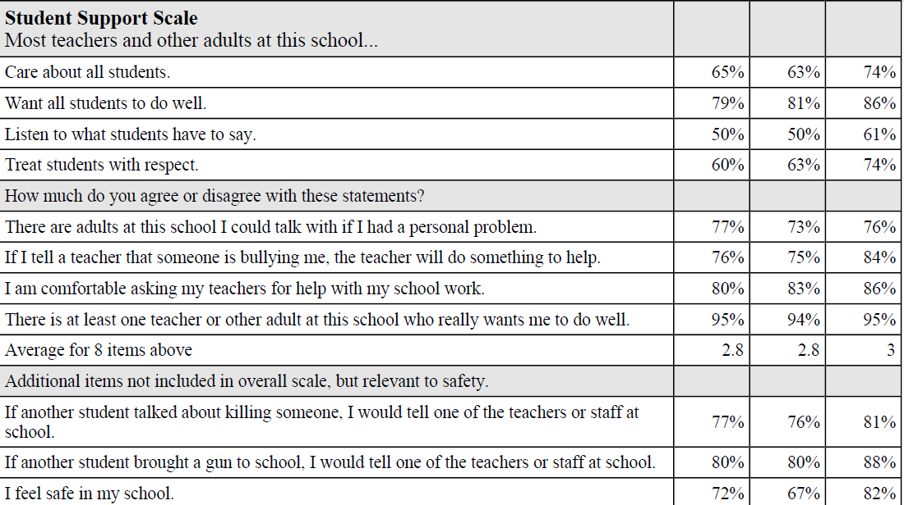
Climate Survey Summary
A Virginia High School
School Region State
Notes:
Sample questions include:
There are adults in this school I can talk with if I had a personal problem.
There is at least one teacher or other adult at this school who really wants me to do well.
If another student talked about killing someone, I would tell one of the teachers or staff at the school.
If another student brought a gun to school, I would tell one of the teachers or staff.

Slide 42
Resources
Resource Development and Technical Assistance Tools
  Publications
  Videos
  Guidance
  Curriculum to support sustainability of trainings

Slide 43
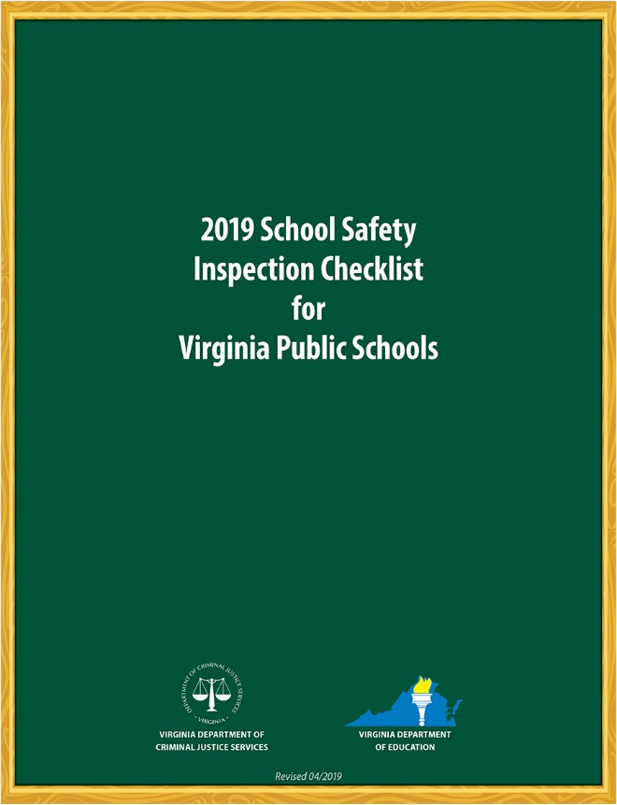
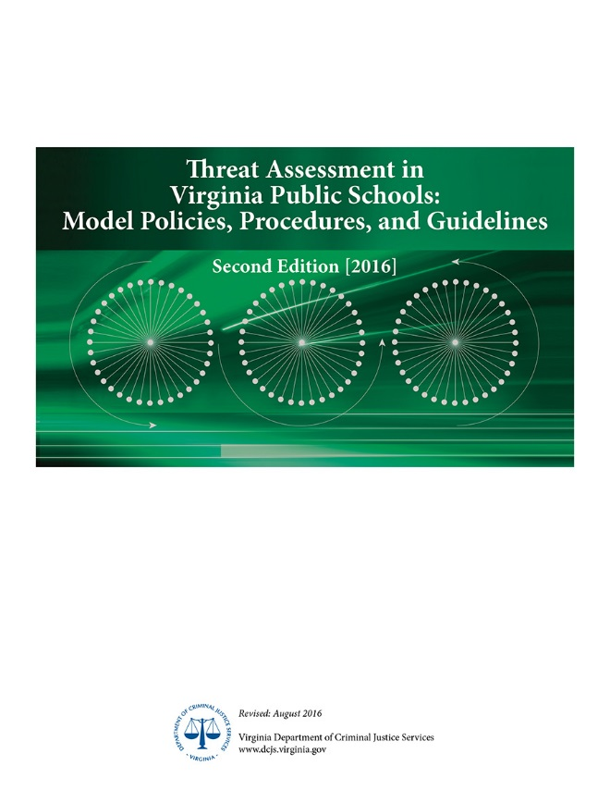
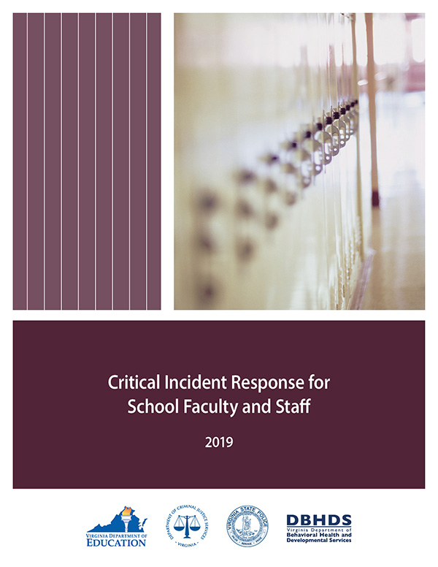
Resources
Mandated

Slide 44
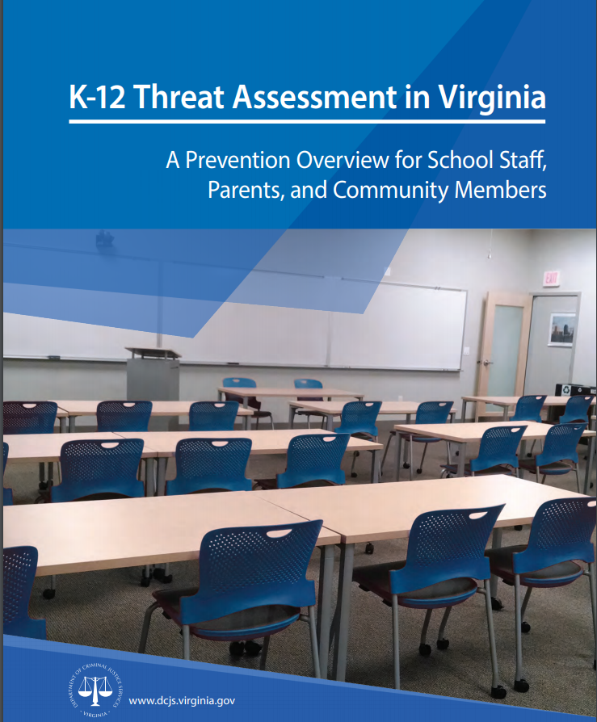
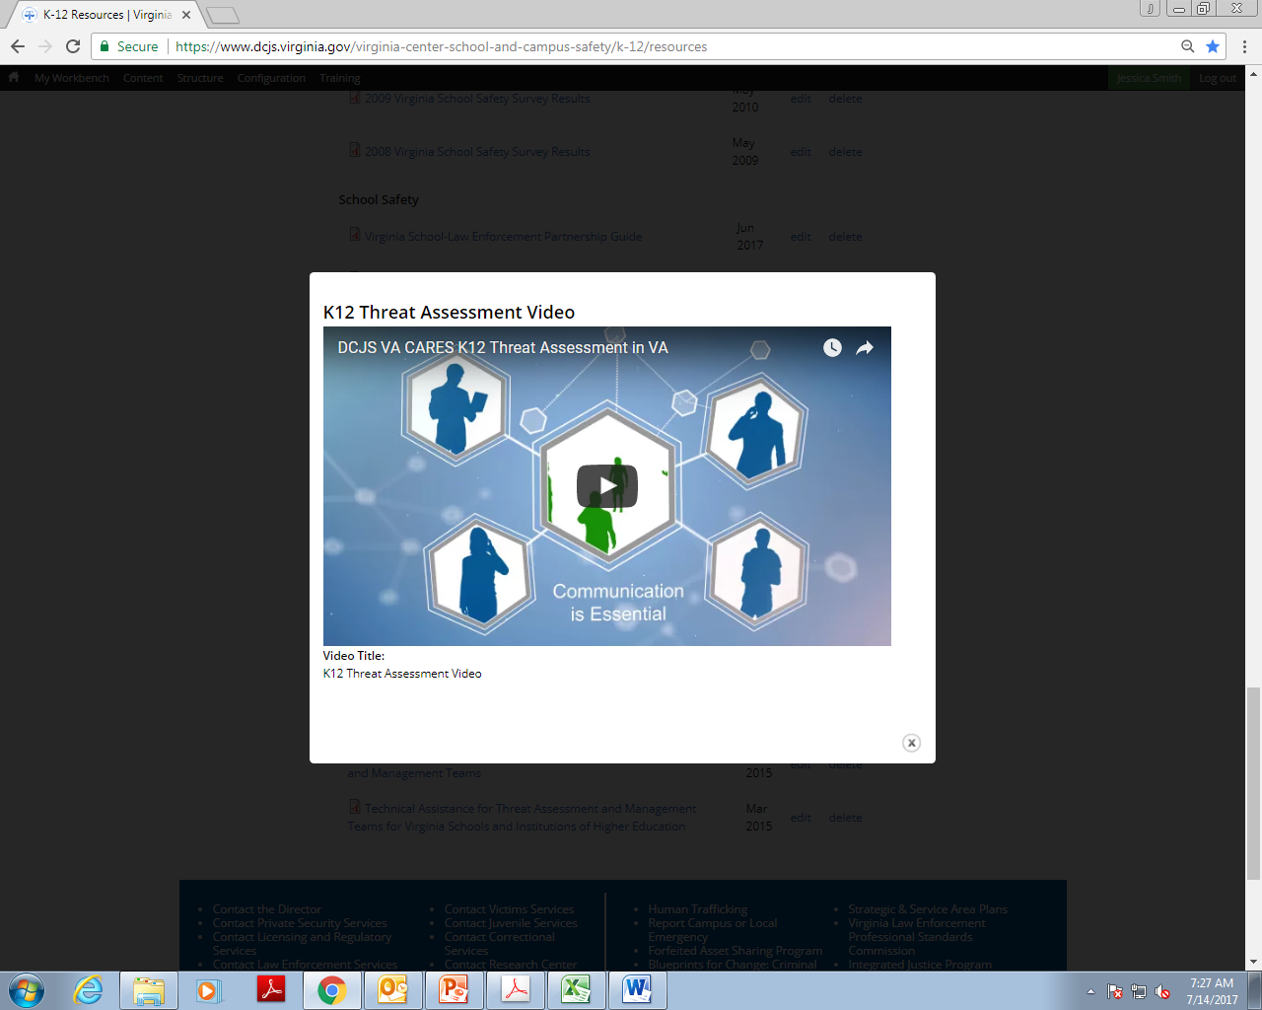
  Resources
K12 Threat Assessment Prevention Manual & Video

Slide 45
Resources
Threat Assessment Model Policies, Procedures, and Guidelines.pdf
Threat Assessment Model Policies, Procedures, and Guidelines.docx
School Threat Assessment Training: Participant Manual
Fillable Threat Assessment Form (Word)
K12 Threat Assessment: A Prevention Overview
Fillable Threat Assessment Form (2016)
K12 Threat Assessment Updates (Summer 2016)
K12 Threat Assessment Video
Request for Service Technical Assistance for Threat Assessment and Management Teams
Technical Assistance for Threat Assessment and Management Teams for Virginia Schools and Institutions of Higher Education
Notes:
§ 9.1-184
Virginia Center for School Safety
A. From such funds as may be appropriated, the Virginia Center for School Safety (the Center) is hereby established within the Department. The Center shall:
Provide training for Virginia public school personnel in school safety, on evidence-based antibullying tactics, and in the effective identification of students who may be at risk for violent behavior and in need of special services or assistance;
Serve as a resource and referral center for Virginia school divisions by conducting research, sponsoring workshops, and providing information regarding current school safety concerns, such as conflict management and peer mediation, bullying, school facility design and technology, current state and federal statutory and regulatory school safety requirements, and legal and constitutional issues regarding school safety and individual rights;
Maintain and disseminate information to local school divisions on effective school safety initiatives in Virginia and across the nation
Collect, analyze, and disseminate various Virginia school safety data, including school safety audit information submitted to it pursuant to § 22.1-279.8, collected by the Department;
Encourage the development of partnerships between the public and private sectors to promote school safety in Virginia;
6. Provide technical assistance to Virginia school divisions in the development and implementation of initiatives promoting school safety;
Develop a memorandum of understanding between the Director of the Department of Criminal Justice Services and the Superintendent of Public Instruction to ensure collaboration and coordination of roles and responsibilities in areas of mutual concern, such as school safety audits and crime prevention; and
Provide training for and certification of school security officers, as defined in § 9.1-101 and consistent with § 9.1-110.
B. All agencies of the Commonwealth shall cooperate with the Center and, upon request, assist the Center in the performance of its duties and responsibilities.

Slide 46
More Resources
Critical Incident Response Video and Accompanying Manual
Guidance for Emergency Manager Designee
Guidance for School Systems in the Event That Victims Arise from an Emergency
Guidance on Required Drill
Juvenile Law Handbook
Model School Resource Officer (SRO) Memorandum of Understanding (MOU) and Program Guide
School – Law Enforcement Partnership Guide
School Crisis, Emergency Management and Medical Emergency Response Plan and Quick Guide
School Safety Audit Infographic
School Safety Audit Template for Divisions
School Safety Audit Template for Schools
School Safety Inspection Checklist
Virginia’s Educator’s Guide to Conducting Drills
Virginia School Bus Driver and Monitor Video and Manual
Notes:
§ 9.1-184
Virginia Center for School Safety
A. From such funds as may be appropriated, the Virginia Center for School Safety (the Center) is hereby established within the Department. The Center shall:
Provide training for Virginia public school personnel in school safety, on evidence-based antibullying tactics, and in the effective identification of students who may be at risk for violent behavior and in need of special services or assistance;
Serve as a resource and referral center for Virginia school divisions by conducting research, sponsoring workshops, and providing information regarding current school safety concerns, such as conflict management and peer mediation, bullying, school facility design and technology, current state and federal statutory and regulatory school safety requirements, and legal and constitutional issues regarding school safety and individual rights;
Maintain and disseminate information to local school divisions on effective school safety initiatives in Virginia and across the nation
Collect, analyze, and disseminate various Virginia school safety data, including school safety audit information submitted to it pursuant to § 22.1-279.8, collected by the Department;
Encourage the development of partnerships between the public and private sectors to promote school safety in Virginia;
6. Provide technical assistance to Virginia school divisions in the development and implementation of initiatives promoting school safety;
Develop a memorandum of understanding between the Director of the Department of Criminal Justice Services and the Superintendent of Public Instruction to ensure collaboration and coordination of roles and responsibilities in areas of mutual concern, such as school safety audits and crime prevention; and
Provide training for and certification of school security officers, as defined in § 9.1-101 and consistent with § 9.1-110.
B. All agencies of the Commonwealth shall cooperate with the Center and, upon request, assist the Center in the performance of its duties and responsibilities.

Slide 47
Trainings and Conferences
Public Safety
Mixed Audience
Campus Safety
School Safety

Slide 48
Trainings and Conferences
Conferences
Annual School Safety Training Forum
Campus Safety and Violence Prevention Forum
The Briefings: A National School Safety Symposium
Strengthening Connections: School Climate Conference
Impact of Trauma on Law Enforcement Officers Conference
Violent Crime Reduction Conference
Threat Assessment Conference

Slide 49
Trainings and Conferences
New Conference for 2019!
National Threat Assessment Conference
for Educational Institutions
November 4–6, 2019
Richmond, Virginia
900 participants
From 35 states and 3 countries!

Slide 50
Trainings and Conferences
19th Annual School Safety Training Forum
July 30- August 1, 2019
Hampton, Virginia
What did you miss????

Slide 51


Slide 52
Who was there??
This conference is a 19 year tradition!
It has grown from just over 100 participants to over 1000 this year!
Law enforcement officers, school security officers, division leaders, school administrators, counselors, and others with a stake in school safety are in attendance from Virginia, Washington DC, Maryland, California, Colorado, Massachusetts, Missouri, Florida, North Carolina, New Jersey, Idaho, Ohio, Vermont, and Canada!

Slide 53

DAY ONE: Leading the Pledge of Allegiance
STUDENT AMBASSADORS:
Alexa Deckert & Kaiden Walters

Slide 54

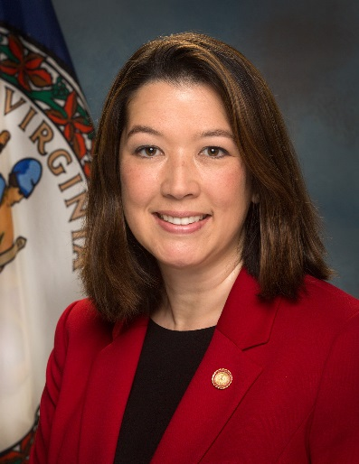
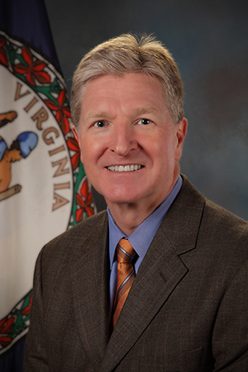
The Welcoming Remarks
Donna Michaelis
VCSCS Director
The Honorable Brian Moran, Secretary of Public Safety and Homeland Security
Shannon Dion
DCJS Director

Slide 55

DAY ONE: Introducing
Donna Michaelis
STUDENT AMBASSADOR:
Sawyer Walters

Slide 56
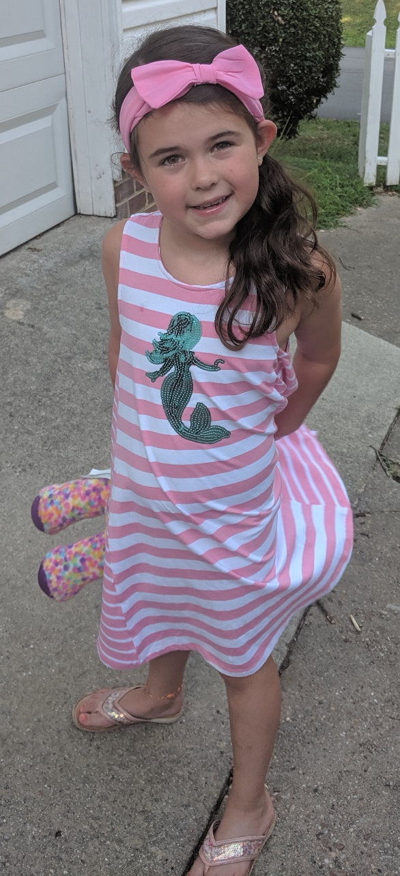
DAY ONE: Introducing
Secretary Moran
STUDENT AMBASSADOR:
Kelsey Deckert

Slide 57

Don’t Fall for the Rope-A-Dope:
De-Escalation in Schools
SPEAKER:
Harry Dolan, Dolan Consulting Group, LLC, Raleigh, NC

Slide 58

Digital Threats: Accessing Publicly Available Social Media Data to Ensure Safe Schools
SPEAKER:
Nick Chernoff, Safer Schools Together (SST)

Slide 59

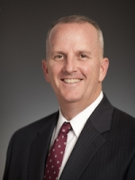
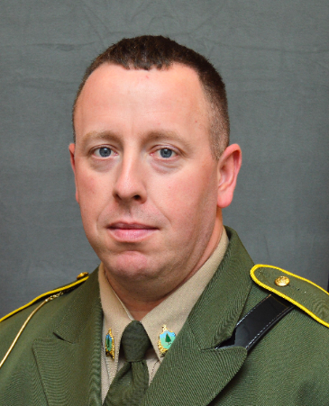
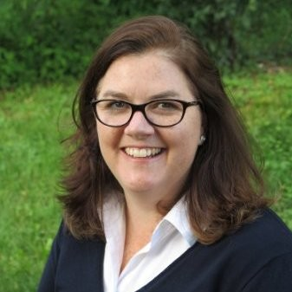

Near Miss: An Averted Attack in Vermont
Brooke Olsen-Farrell, Superintendent, Slate Valley Unified School District
Jason Rasco, Fair Haven High School Principal, Slate Valley Unified School District
Bill Humphries, Chief of Police, Fair Haven
Henry Alberico, Detective Sargent, Vermont State Police
Rob Evans, Vermont School Safety Liaison
Rosemary Kennedy, State's Attorney

Slide 60
FERPA, HIPPA, and Other Key Information Sharing Tidbits
SPEAKER:
Bradford King, Attorney, Sands Anderson

Slide 61
Day One Workshops
SOCIAL MEDIA: Online Safety and Cyber Threats
DATA TRENDS: Criminal Justice Trends in Virginia
DATA TRENDS: SROs and SSOs in Virginia Schools: What the Data Says
DRUGS & ALCOHOL RESISTANCE: JUULING and All That Jazzy Drug Technology
DE-ESCALATION: Verbal De-escalation in Schools - Fundamentals of Success
AVERTED THREAT: Question and Answer Panel Opportunity
GANGS: Transnational Gang Training and Familiarization
THREAT ASSESSMENT BEST PRACTICES: A Holistic Approach to Prevention
NCMEC: Bringing Together the Best: How to Leverage Resources through the National Center for Missing & Exploited Children
TITLE IX: What Schools Need to Know
VIRGINIA RULES: The Basics

Slide 62
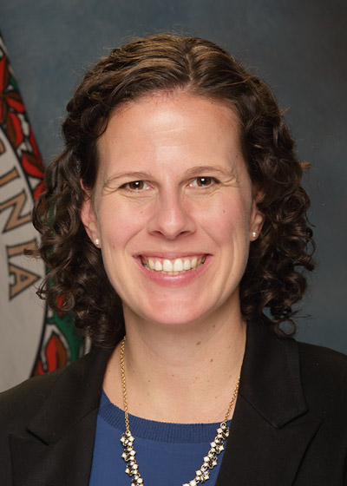
Address by the Deputy
Secretary of Education
The Honorable Holly Coy
DAY TWO

Slide 63
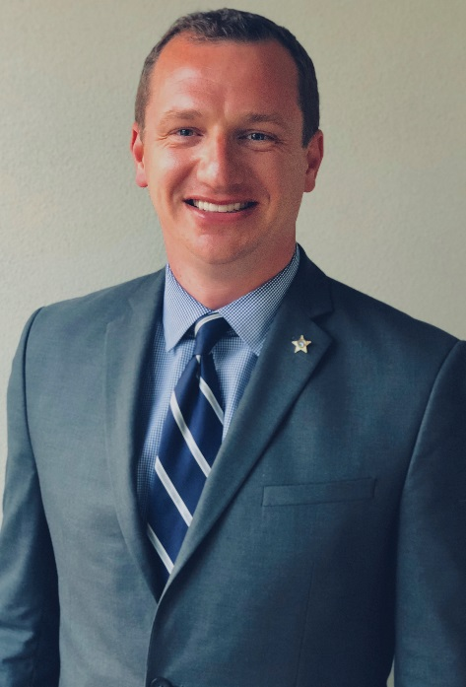

An Overview of the Findings of the Marjory Stoneman Douglas Public Safety Commission
DAY TWO
SPEAKER:
Sgt. John Suess

Slide 64

Hate Speech, Crime, and
Recruitment in Schools
DAY TWO
SPEAKER:
Dr. John More, President & CEO, Response Law, LLC

Slide 65
Day Two Workshops
D.A.R.E. UPDATES: D.A.R.E. Rx/OTC and Opioid Enhancement Lesson Certification Training, D.A.R.E. America and Virginia D.A.R.E. Training Center (VDTC) Updates
EMERGENCY PLANNING:
Building Resilient Communities - The Holy Grail of Preparedness
Unpacking the Department of Homeland Security Tabletops
HUMAN TRAFFICKING: Identification and Advocacy for Human Trafficking Victims in Schools
LEGAL: Legal Update and Information Sharing for School Administration and LEOs
DE-ESCALATION: Tilt the Prism - De-escalation Techniques for School-based Super Heroes
DISABILITY AWARENESS FOR SCHOOLS
INTERVENTIONS: What Students Need and How to Ensure They Receive It, From a School Counselor’s Perspective
EMERGENCY PLANNING: Drills and Barricades from the Fire Marshal’s Perspective
VIRGINIA RULES: Tips and Tricks for the Experienced User

Slide 66

DAY THREE
KEYNOTE
Tragedy to Triumph: A Story of Resilience
C.J. Huff, Ed.D., Former Superintendent, Joplin, Missouri

Slide 67
Trainings and Conferences
GET READY!!
The Briefings: A National School Safety Symposium
May 6, 2020
Northern Virginia

Slide 68
Trainings and Conferences
GET READY!!
Two Day
Crisis Management Institutes
July 21-22, 2020 – Abingdon
July 23-24, 2020 - Lynchburg

Slide 69
Trainings and Conferences
GET READY!!
^{20th} Annual School Safety Training Forum
July 28 - 30, 2020
Hampton, Virginia
National School Safety Summit
July 27, 2020
Over 1200 participants expected!!

Slide 70
Trainings and Conferences
School Safety
      School Resource Officer and School Administrator Training
      Adult Sexual Misconduct in Schools
      Bomb Threat Management in Schools
      Human Trafficking for Schools
      K12 Threat Assessment
      Identification of Aberrant Behavior
      Legal Issues Concerning K12 Threat Assessment
      Gang Awareness for School Personnel
      Title IX Investigations and the Role of the Office for Civil Rights

Slide 71
Trainings and Conferences
School Safety
      Trauma Informed Classrooms and Schools
      Next Steps in Crisis Management Planning
      Critical Incident Response
      Civilian Response to Active Shooter Events
      Social Media for Educators
      Title IX Investigations and the Role of the Office for Civil Rights
      Drug Abuse Awareness and Prevention
      Trauma Informed Discipline Practices
      Restorative Justice Practices
      Impact of Implicit Biases

Slide 72
Trainings and Conferences
Campus Safety
      Basic & Advanced Campus Threat Assessment
      Campus Crime Prevention
      Enhancing the Campus & Community Response to Adult Sexual Assault
      Trauma Informed Sexual Assault Investigations
      Investigation of Dating Violence, Domestic Violence, and Stalking for Campus Police

Slide 73
Trainings and Conferences
Campus Safety
      Title IX Investigations
      Managing Critical Incidents for Higher Education Institutions
      Mental Health First Aid for Higher Education
      Strategic Legal Guidelines for University Police Operations

Slide 74
Trainings and Conferences
Public Safety
      Disability Awareness for Law Enforcement Officers (TTT)
      Financial Investigations in Heroin and Opioid Abuse
      Dynamics of Officer/Citizen Encounters
      Interview and Interrogation Skills
      Animal Cruelty and Fighting Investigations
      Homegrown Violent Extremists (HVEs)

Slide 75
Trainings and Conferences
Public Safety
      Law Enforcement First Responders Training Program
      Sovereign Citizens Movement Training
      Gang Awareness and Investigation Training
      Fair and Impartial Policing Training Human Trafficking Investigations
      Introduction to Domestic Extremism and Hate Groups
      Adult and Youth Mental Health First Aid
      Applied Suicide Intervention Skills Training
      Social Media Awareness

Slide 76
Future Plans
Development of a statewide Threat Assessment Case Management Tool
Development of online learning modules
Publication of “white papers” / FAQs for sensitive issues and information sharing
More research on data collected and its impact on schools
Cadre of threat assessment trainers for sustainability

Slide 77
DCJS Virginia Center for
School and Campus Safety
We are here to help! www.dcjs.virginia.gov
Donna Michaelis • (804) 371-6506
donna.michaelis@dcjs.virginia.gov
Notes:
Thank you for your time and this opportunity.

