Slide 1
School Enrollment Trends in a Post-Pandemic Virginia
VASS-VASBO Winter Conference
January 8th, 2024
Hamilton Lombard
Hamilton.Lombard@virginia.edu

Slide 2
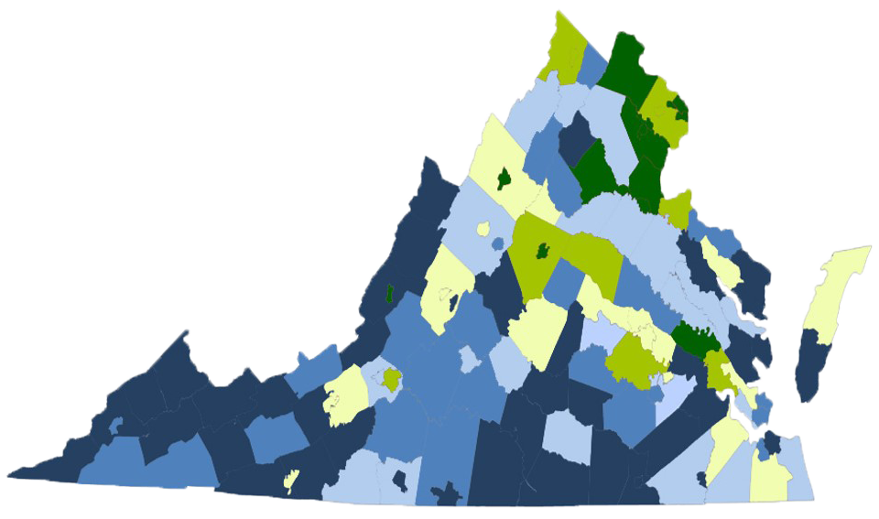
Enrollment growth was concentrated in Virginia's largest divisions during 2010s
Virginia’s school age population and public K-12 enrollment growth during the 2010s was driven almost entirely by Northern Virginia
Enrollment in 69 of Virginia’s 95 counties declined
Change in Public School K-12 Enrollment, 2010 to 2019

Slide 3
Virginia’s K-12 enrollment grew steadily during the 2010s
Both Virginia’s school age population and public K-12 student enrollment grew every year between 1984 and 2018
K-12 student enrollment was still growing before pandemic
Virginia Public School Enrollment (K-12)

Slide 4
By the end of the 2010s, Virginia’s elementary school enrollment was already shrinking
Virginia Public School Enrollment

Slide 5
During the 2020s, enrollment decline was expected to spread to Virginia’s upper grades
Virginia Public School Enrollment Projection

Slide 6
Prior to Covid-19, Virginia’s K-12 enrollment was expected to begin to decline in the 2020s
In 2019, public schools were on course to lose close to 50,000 students during 2020s
During the 2020s, the school age population was expected to decline in number
Virginia Public School Projections (K-12)

Slide 7
Births have declined nearly every year since 2007
Annual births have declined by 11 percent in Virginia since 2007
The decline in births since 2007 is the primary reason for the projected decline in Virginia’s K-12 enrollment
Virginia Annual Births

Slide 8
Birth rates are highly predictive of future school enrollments in Virginia
Fewer births has meant fewer kindergartners in Virginia
Five years after births peaked in Virginia in 2007, kindergarten class sizes began declining
Births and Kindergarten Enrollment

Slide 9
The shift to out-migration has slowed Virginia’s population growth
Each year since 2013, more people have moved out of Virginia to other states than into Virginia.
The largest shift to out-migration in Virginia was among children and their parents
Virginia Net Domestic Migration

Slide 10
Virginia’s public schools have lost thousands of students since Covid-19
Virginia’s public schools in 2023 had over 40,000 fewer students than projected in 2019
Pre-pandemic trends are expected to cause Virginia’s public school enrollment to continue to decline over the next decade
Virginia K-12 Public School Enrollment

Slide 11
Thousands of students are still missing from Virginia’s public schools
In 2023, the most students missing from public school were 3nd graders, who would have enrolled as kindergartners in 2020
The many missing kindergartners and 1st graders in 2023 suggest a permanent increase in share of children being educated privately
Expected vs Actual Public School Enrollment (2023)

Slide 12
The pandemic accelerated growth in private K-12 education
Both private and home school enrollment was growing relatively quickly before 2020
Enrollment in private schools continued to grow in 2023
Change in K-12 Enrollment since 2010

Slide 13
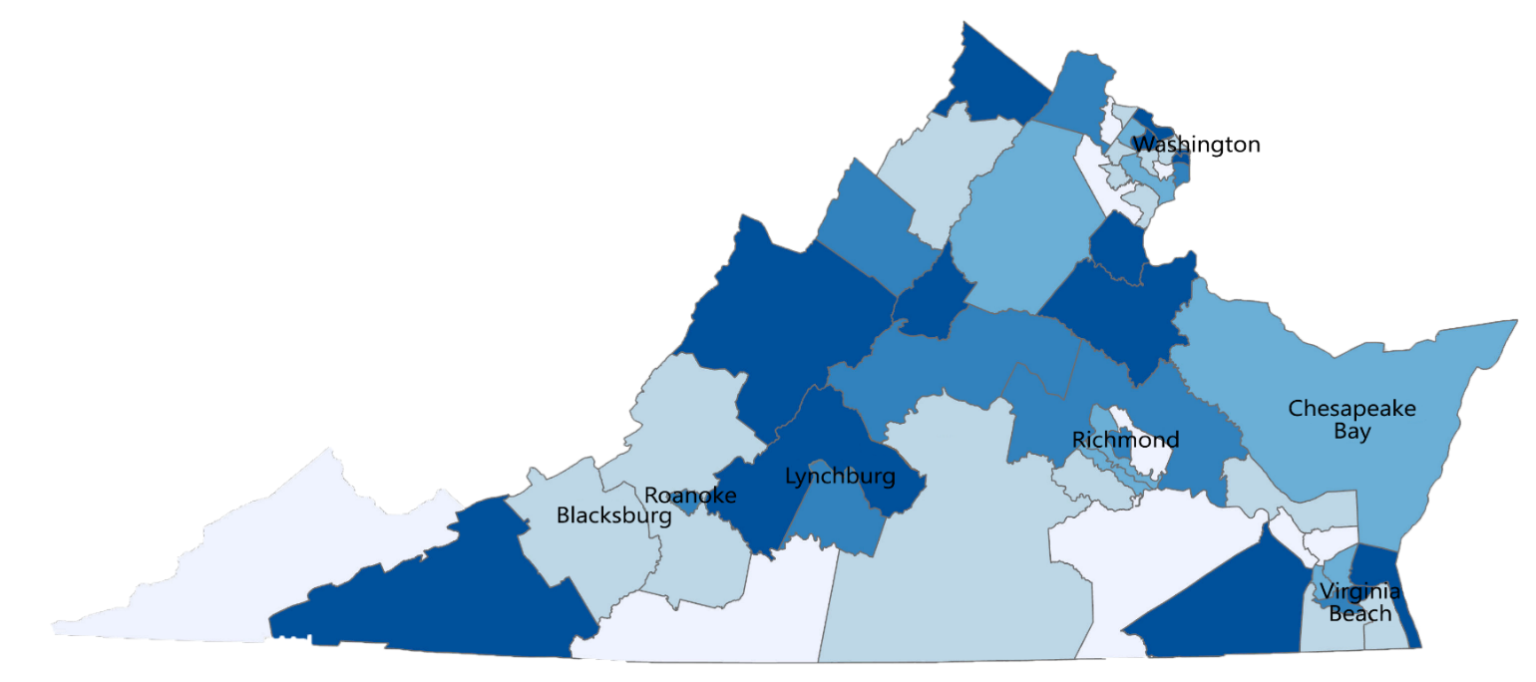
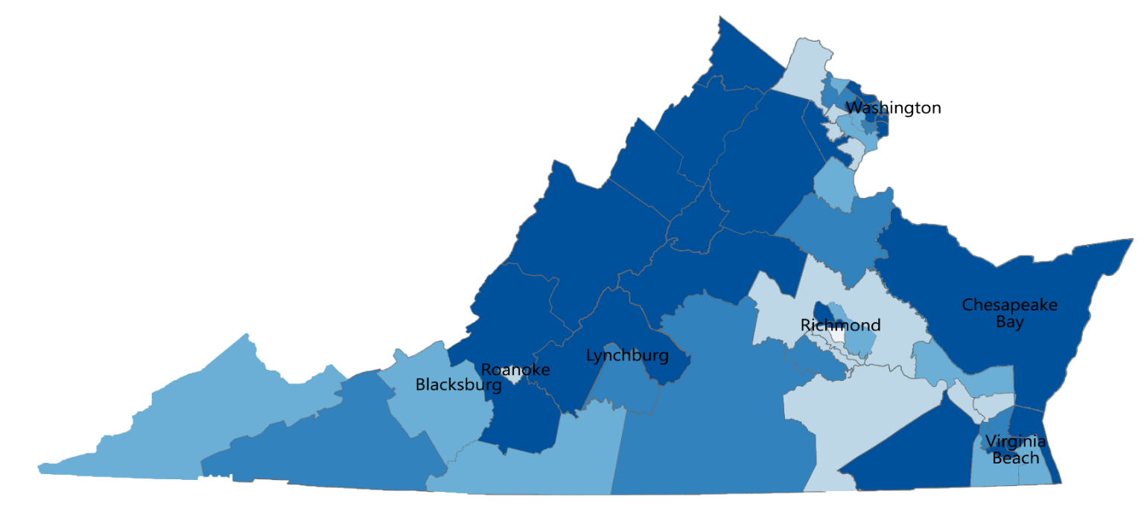
The share of K-12 students educated privately has risen across Virginia since 2019
2019
Less than 8%
8 to 10%
10 to 12%
12 to 14%
Over 14 %
2022
Private K-12 Enrollment in 2019 and 2022 Census American Community Survey

Slide 14
More young Virginians are attending college
In recent decades, the share of the workforce with a college degree has grown rapidly
During the same period, the number of adult Virginians without a college degree has fallen
Change in Educational Attainment for Virginians (ages 25 to 50), Census American Community Survey

Slide 15
Women are waiting longer to start families and are having fewer children
Two-thirds of the decline in births has been among mothers 20 and younger
Some of the decline in births is from women delaying motherhood
U.S. Annual Births by Mother’s Age, CDC Birth Data

Slide 16
Births have not declined evenly throughout Virginia
During late 2000s recession, births declined the most in rural communities and small metro areas
Since the mid-2010s, births have declined sharply in Northern Virginia. Births have fallen by 15 percent in Fairfax and by 24 percent in Arlington
Change in Births by Region since 2007

Slide 17
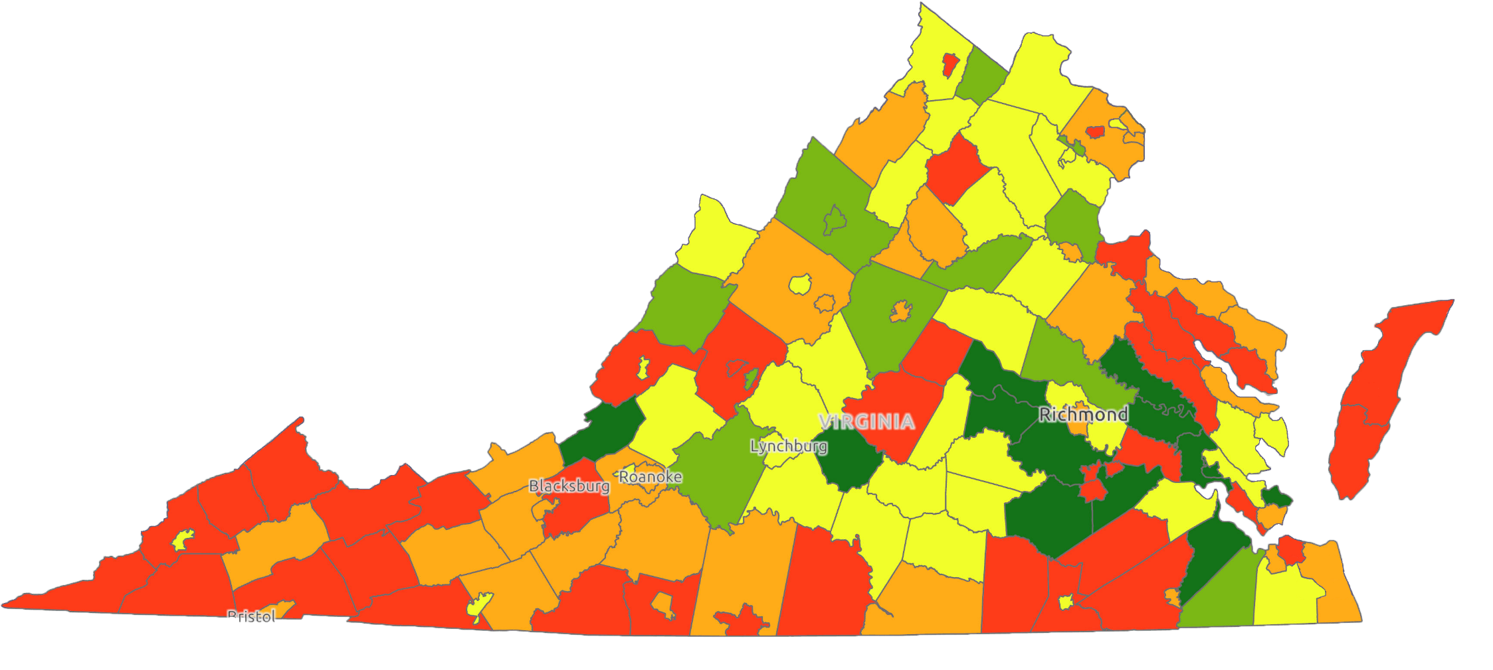
Virginia’s birth trends are more mixed at the local level
Declined more than 20%
Declined 10 to 20%
Declined 0 to 10%
Grew 0 to 10%
Grew more than 10%
Change in Births 2007 to 2022

Slide 18
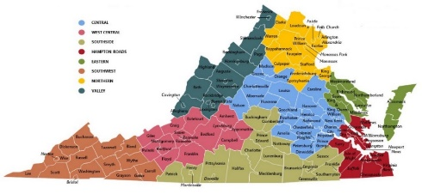
Birth trends will cause the school-age population to shrink during the 2020s
Fewer births will mean widespread enrollment decline during the 2020s
Enrollment in some of Virginia’s regions will still grow during the 2020s
Pre and Post Pandemic: K-12 Public School Enrollment Change

Slide 19
Enrollment trends during the 2020s are expected to be different from the 2010s
Enrollment is expected to decline in most divisions, regardless of the size
During the 2020s, enrollment trends in most large and small divisions will be more similar to each other than in recent decades
Change in Enrollment Since 2013 by Division Size

Slide 20
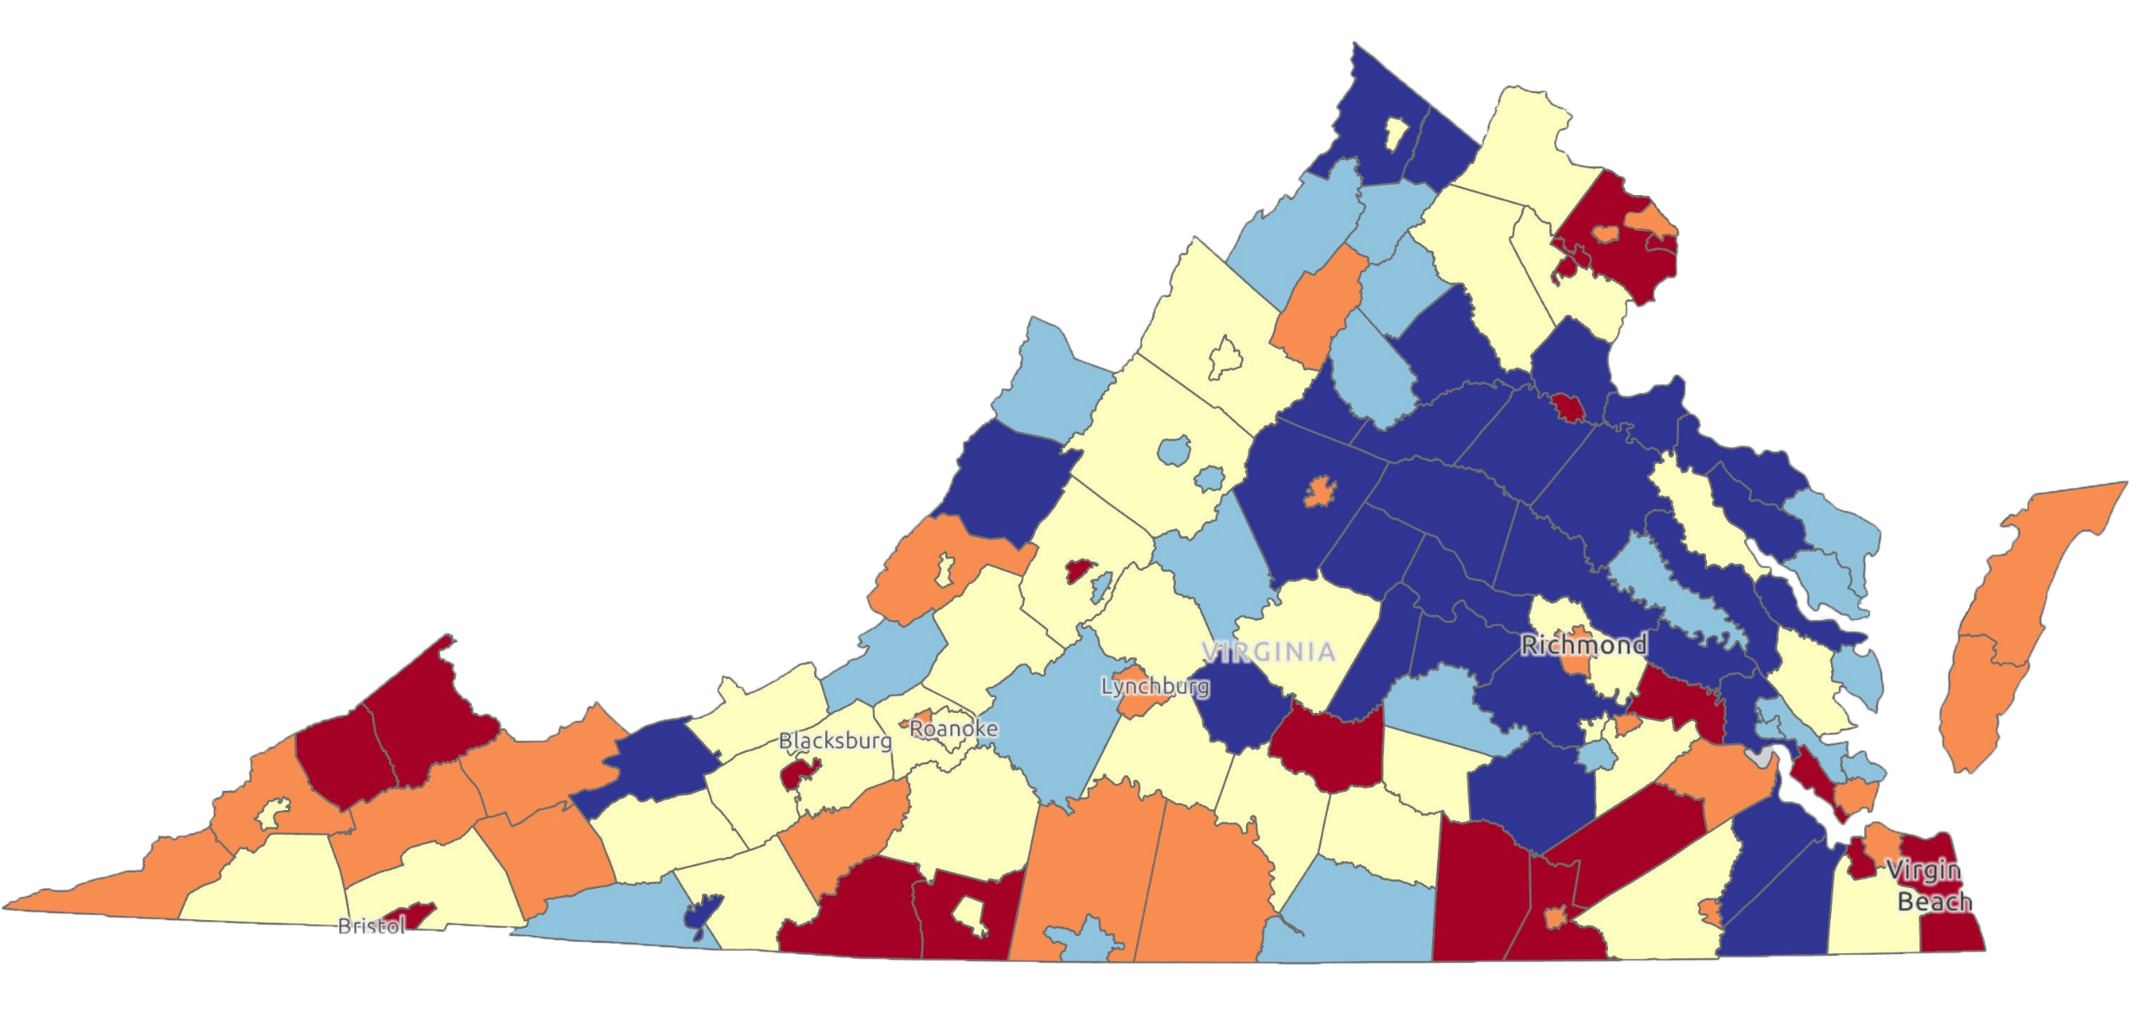
Population change from migration between 2020 and 2022
Declined over 1%
Declined 0 to 1%
Grew 0 to 1%
Grew 1% to 2%
Grew more than 2%
Net-migration, UVA Weldon Cooper Center Population Estimates

Slide 21
Since 2020, families have increasingly left urban areas
Change in 35- to 39- Year-Old Population since 2020
Declined over 5%
Declined 0 to 5%
Grew 0 to 2.5%
Grew 2.5% to 5%
Grew more than 5%

Slide 22
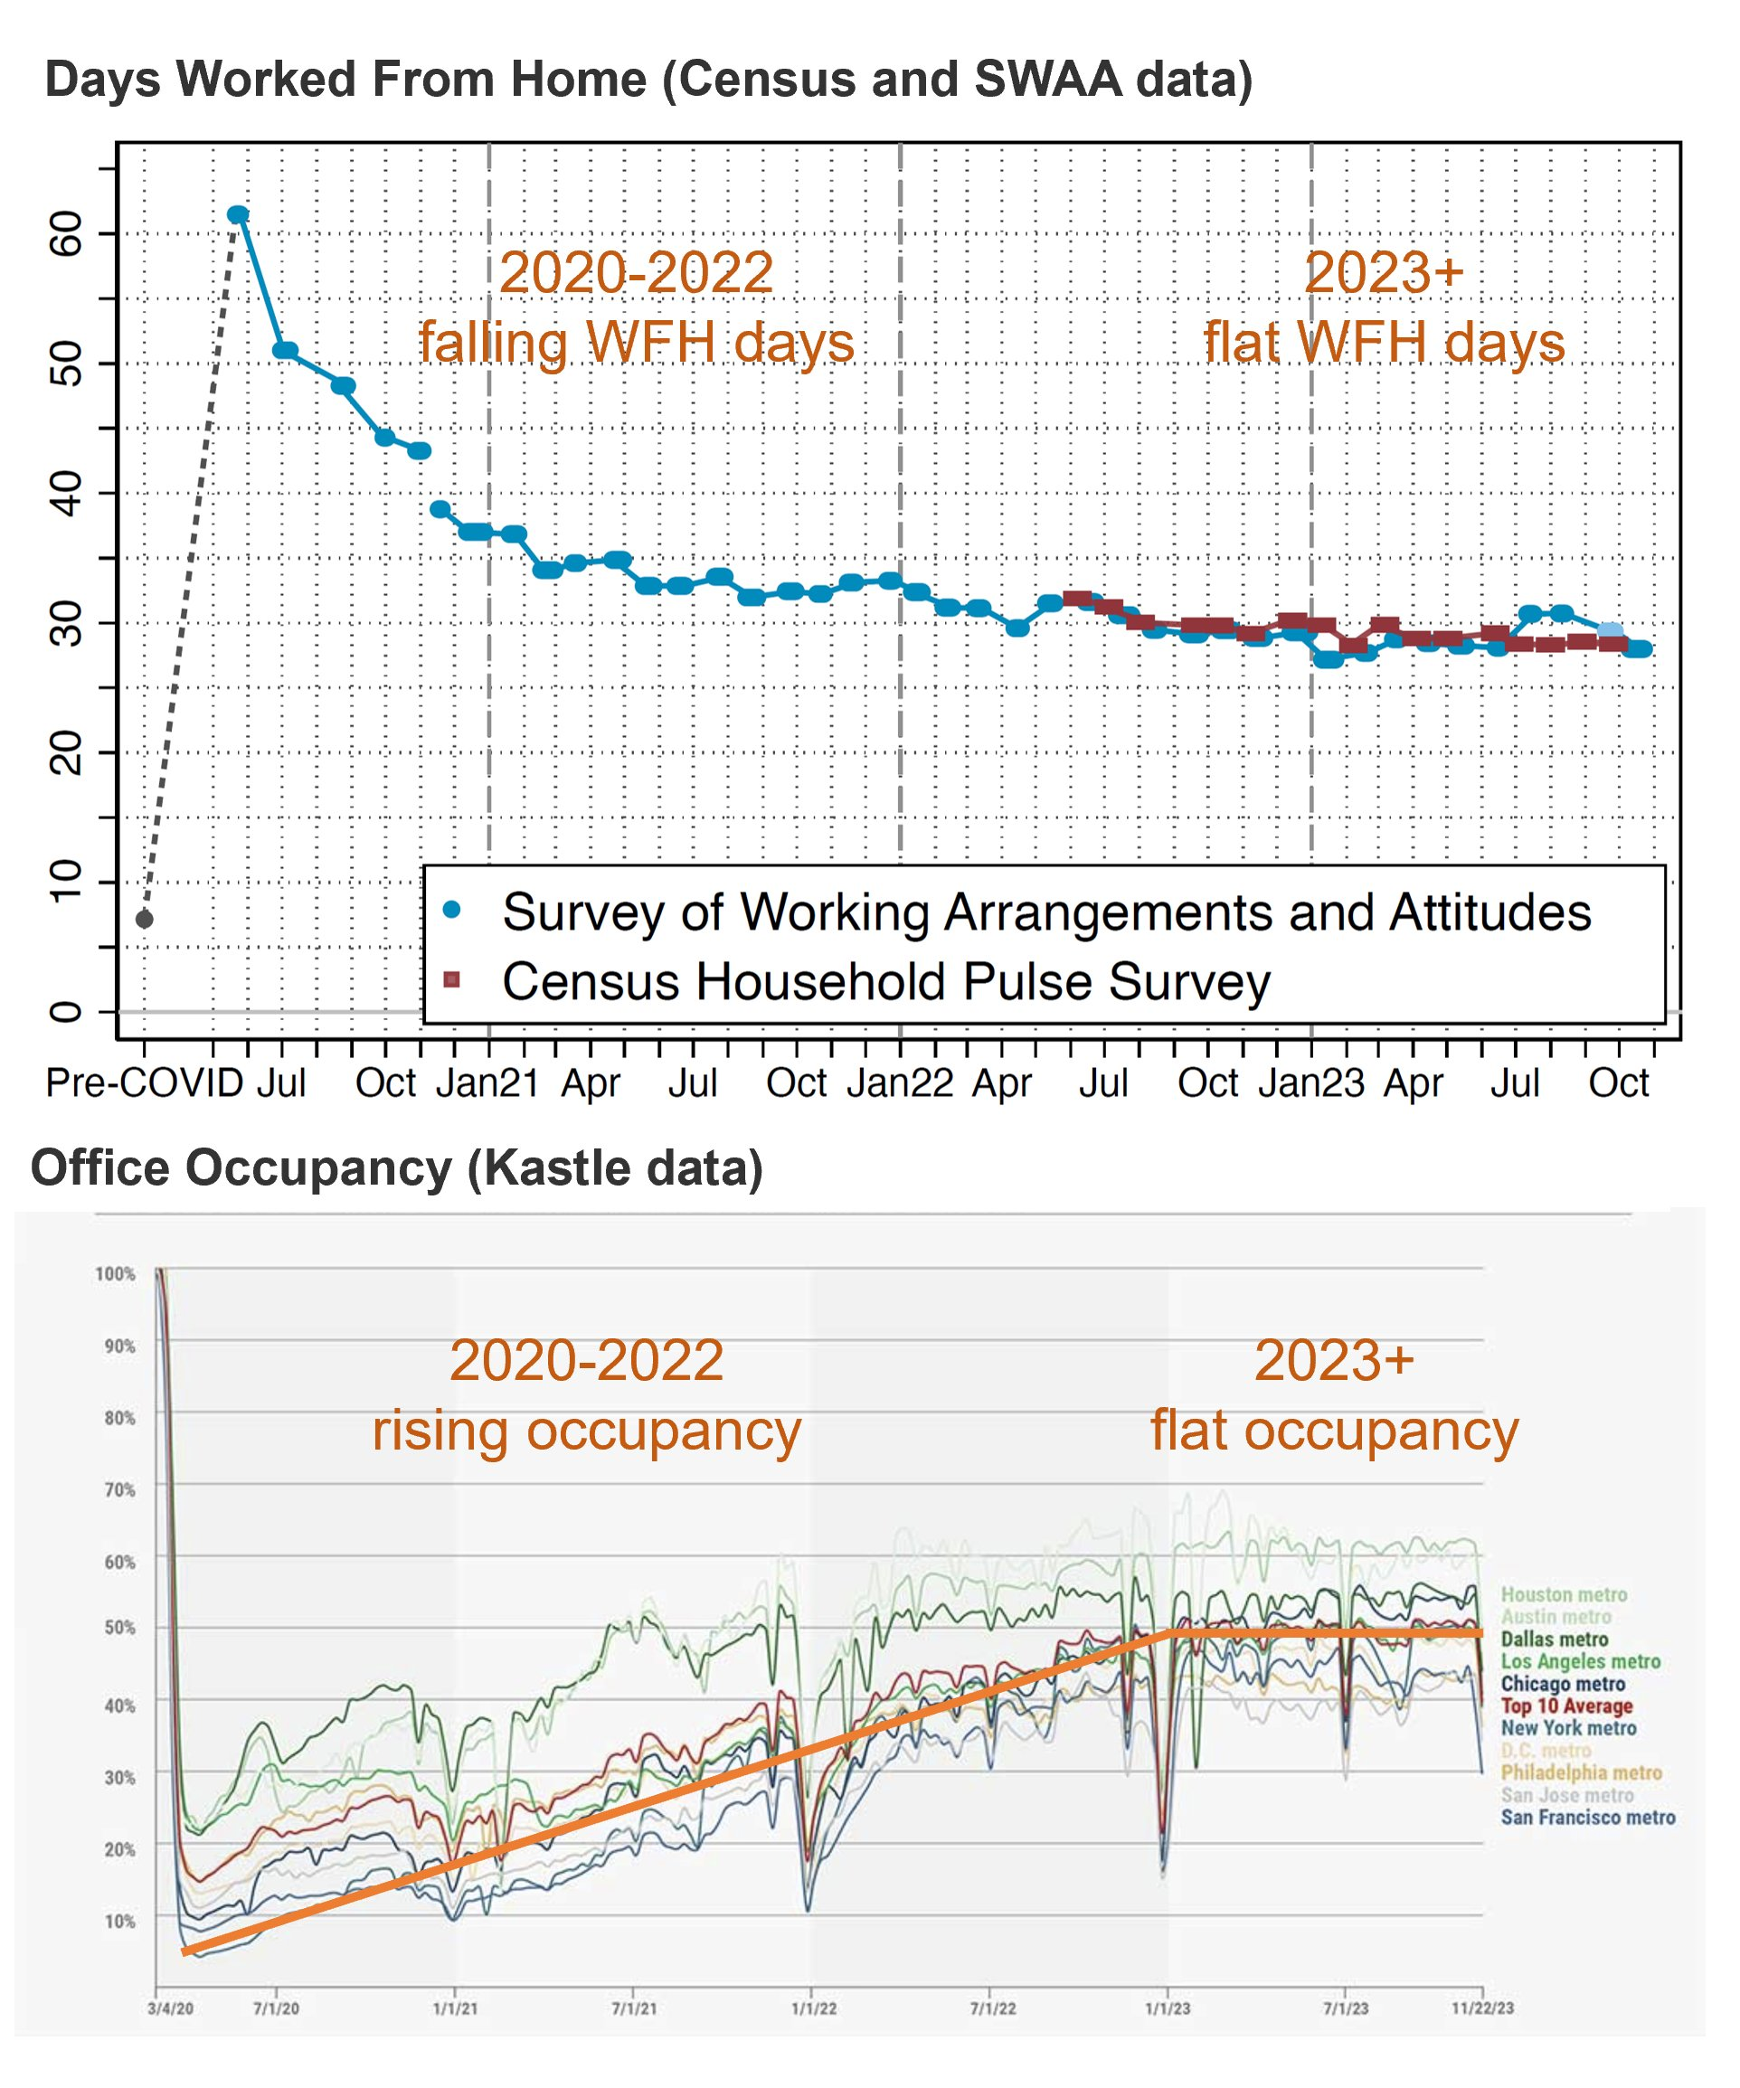
Remote work is not going away

Slide 23
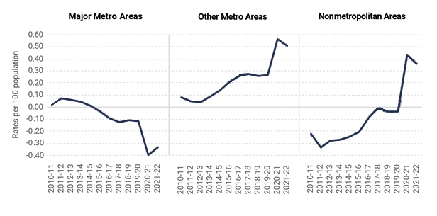
Recent migration trends are very different from the past
Net Domestic Migration from Census Bureau Annual Population Estimates

Slide 24
School Enrollment Trends in a Post-Pandemic Virginia
VASS-VASBO Winter Conference
January 8th, 2024
Hamilton Lombard
Hamilton.Lombard@virginia.edu

