Slide 1
VCCS Update:
Virginia Association of School Superintendents
Virginia Association of School Business Officials
January 8, 2024
Ellen Davenport, Associate Vice Chancellor, VCCS

Slide 2
Outline for today
VCCS Background and Facts
Signature Programs and Existing Initiatives
Transfer Virginia
Credits to Careers
G3
New Economy Workforce Credentials Grants (“FastForward”)
Challenges Ahead
Future Priorities

Slide 3
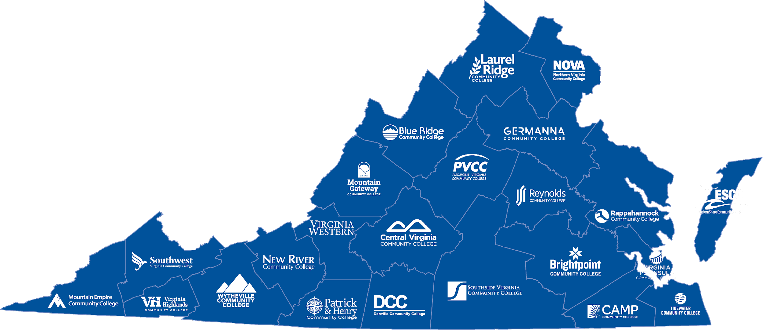
23 colleges
230,000 Students Served
93,798 minority students

Slide 4
81% of students stay and work in Virginia
For every $1 invested, students gain $5.70 in lifetime earnings and taxpayers gain $2.70 in added tax revenue and public sector savings
Society gains $8.80 in added income and social savings

Slide 5
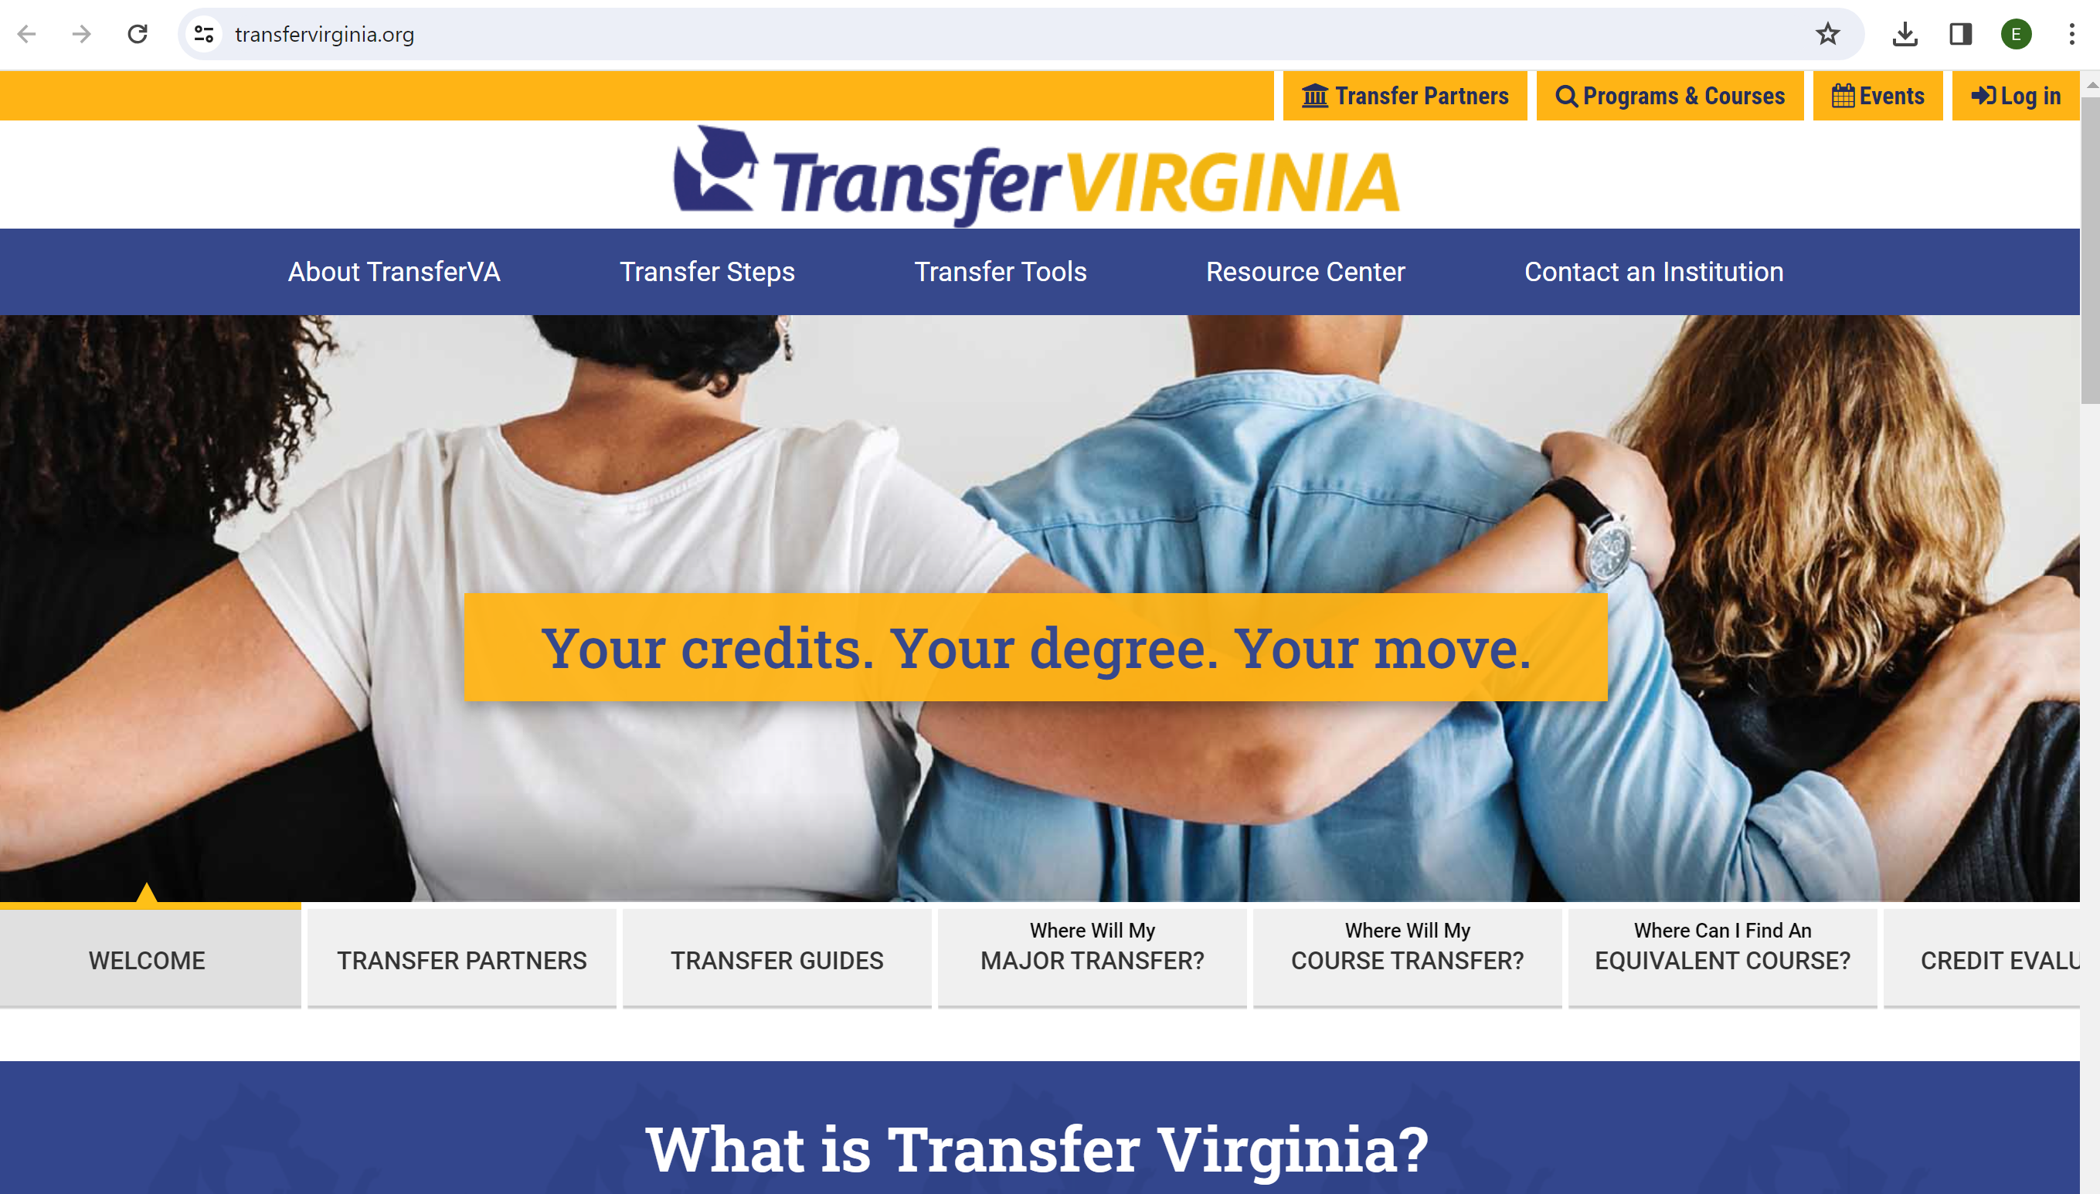

Slide 6
Overarching goal is to streamline choices for students which improve college success and improve credit efficiency, time to transfer, and degree attainment
Portal (transfervirginia.org) guides students to explore where they want to end up after high school
Prospective pathways map from high school to community college to four-year college or university degree completion

Slide 8
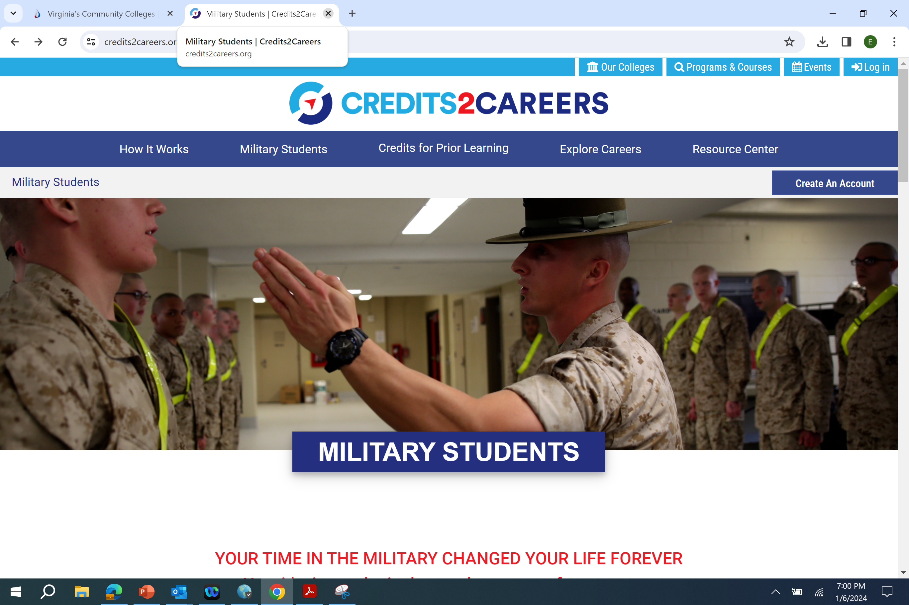

Slide 9
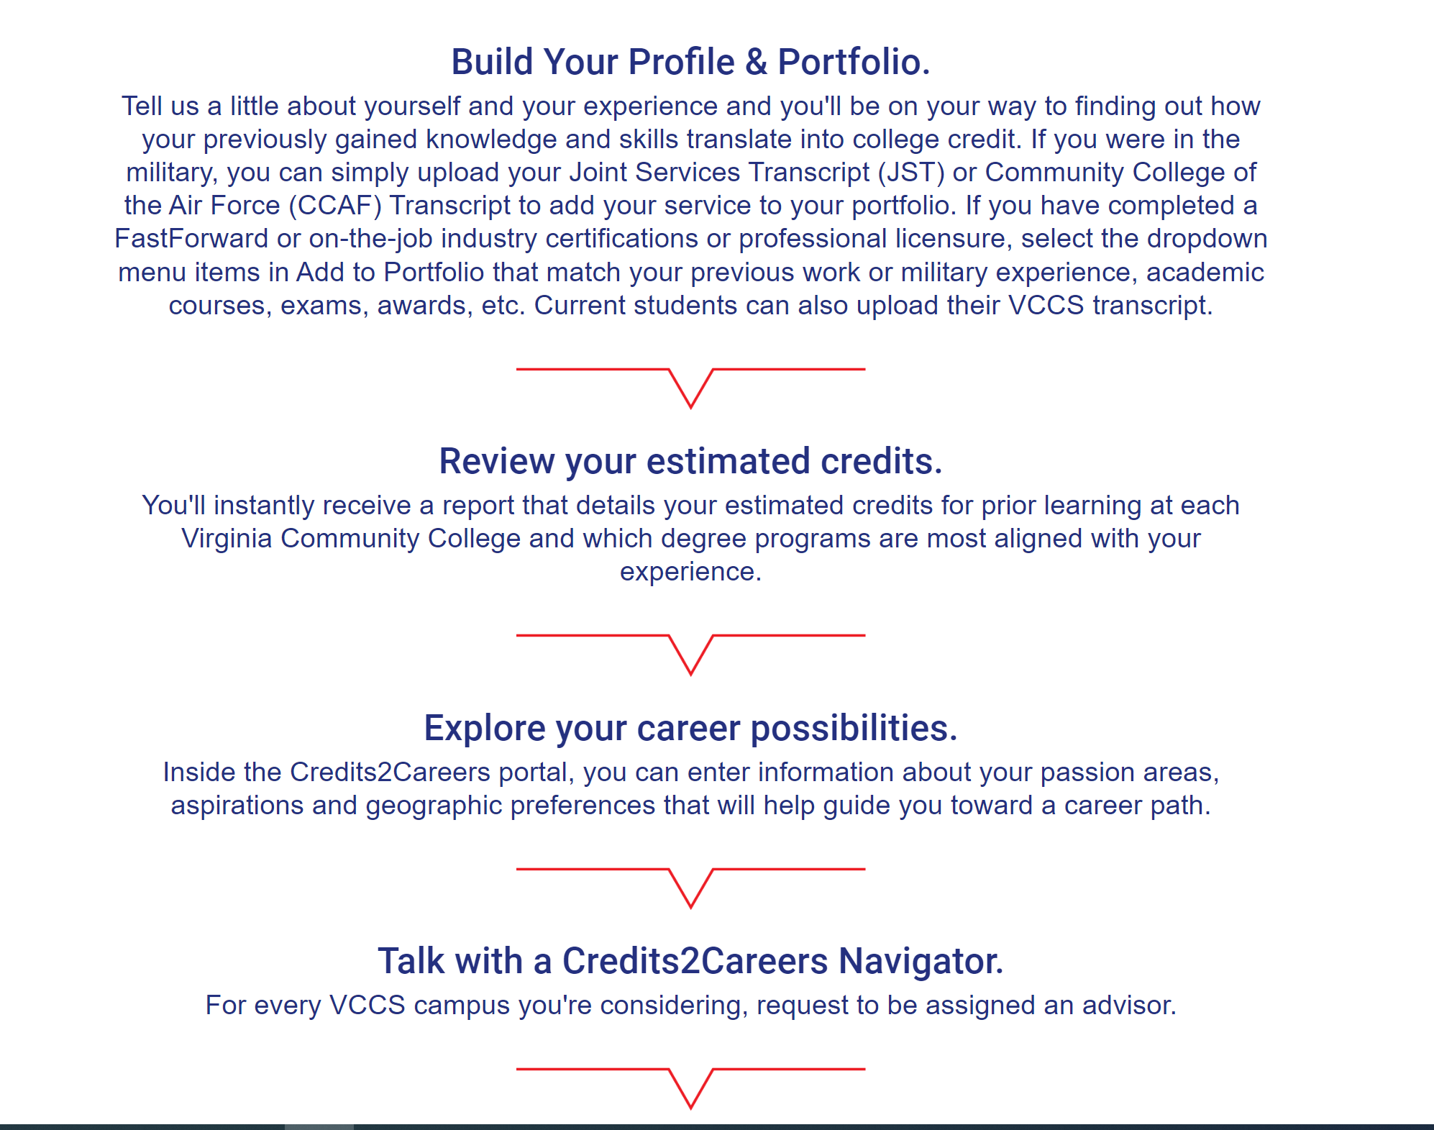

Slide 10
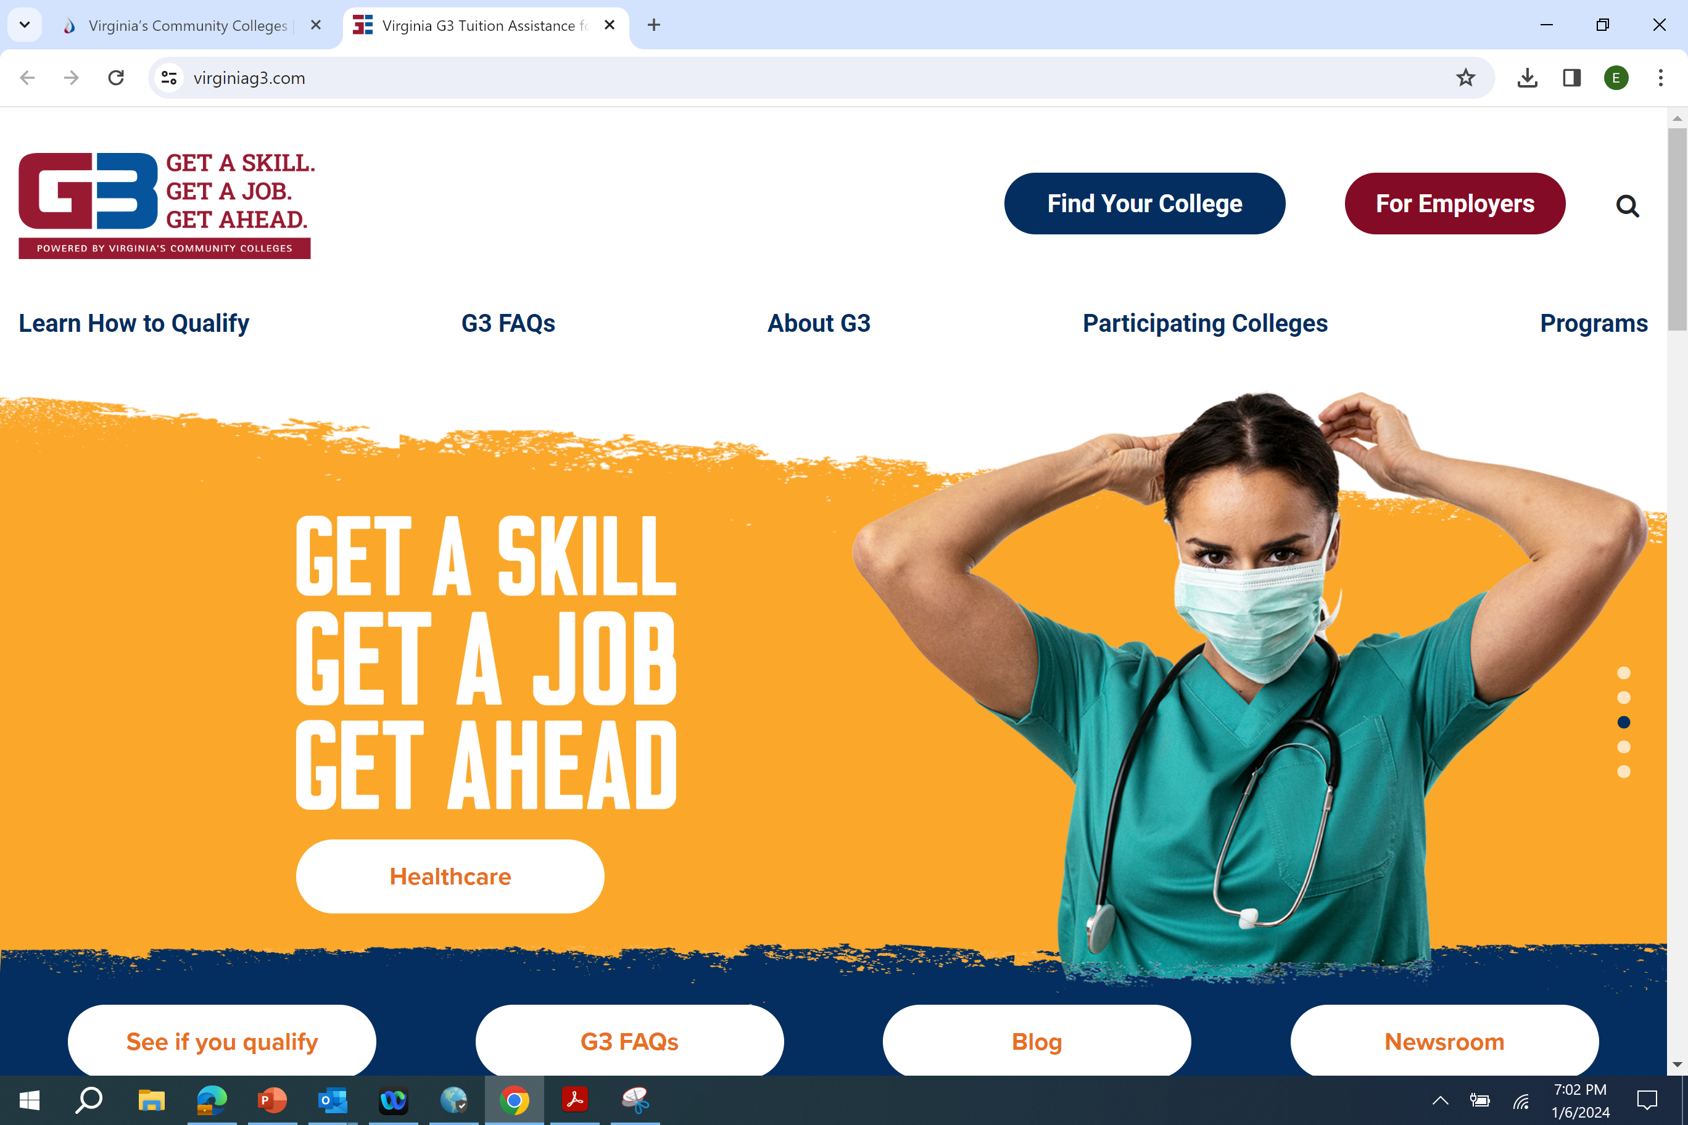

Slide 11
G3: Get A Skill, Get A Job, Get Ahead
Last Dollar, State Financial Aid Program (student must fill out a FAFSA and access federal financial aid first)
Can begin with skills training that leads to a certificate that has immediate value in the job market.
Certificate is part of an applied associate degree program,
A working student can continue to “stack” additional certificates on the pathway to an associate degree.
5 tracks: Skilled Trades, Information Technology, Early Childhood Education, Healthcare, Public Safety

Slide 12
Accelerated career training program Prepares students to obtain third-party, industry recognized credentials Student pays 1/3, Commonwealth pays 1/3 after training is completed, Commonwealth pays remaining 1/3 upon credential attainment

Slide 13
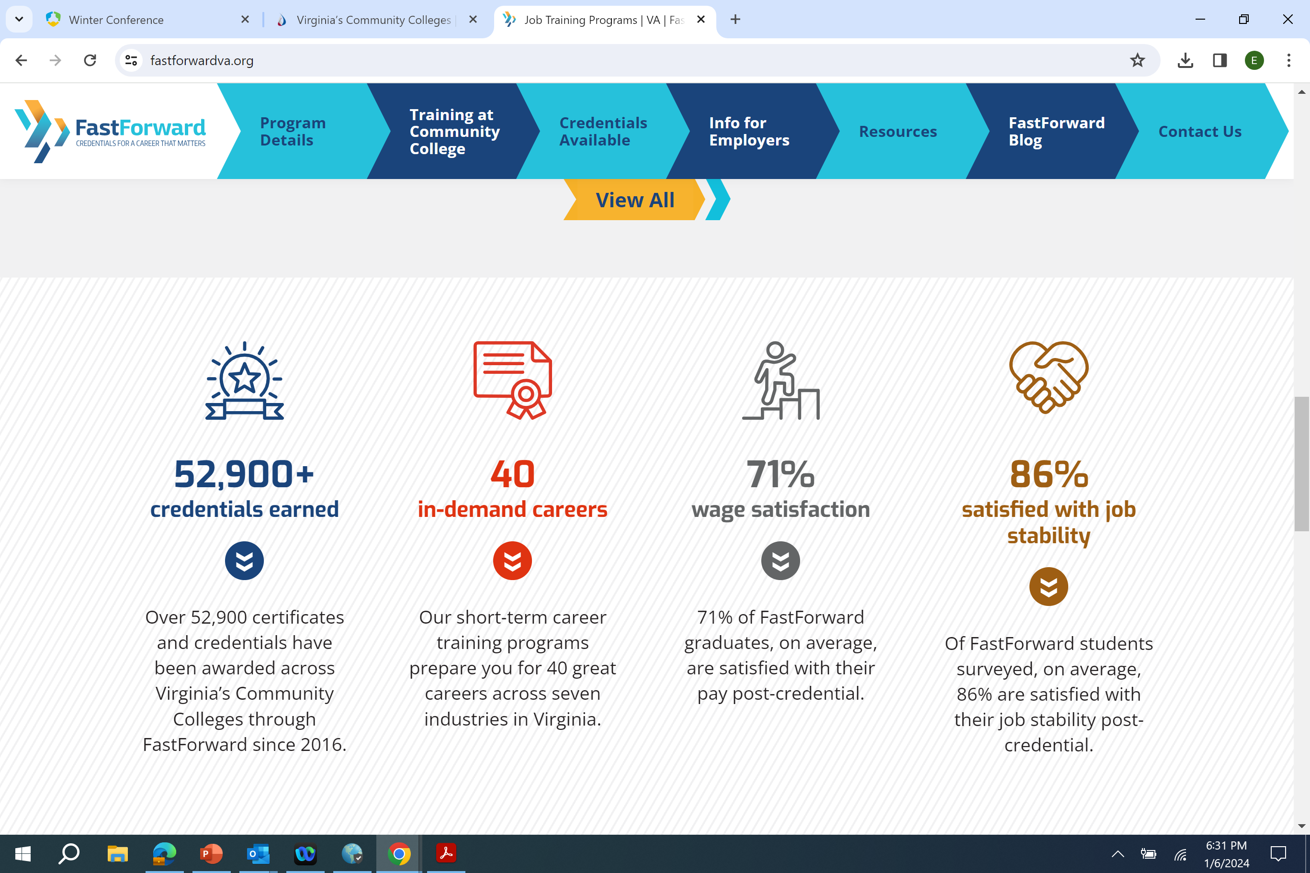

Slide 14
Examples: Commercial Truck Driving, Welding, Certified Nurse Aide Domiciled in Virginia Now available to high school seniors who meet all requirements to graduate on time as determined by the school division and have parental permission if <18 years old

Slide 15
CHALLENGES
AHEAD
Skills gap in Virginia and unfilled jobs
Virginia’s net migration of college-educated people-- negative for 9 years
Birth dearth leading to declining K-12 student pipeline

Slide 16
EDUCATIONAL ACHIEVEMENT
TECHNOLOGY
SKILLS
THE GAPS

Slide 17
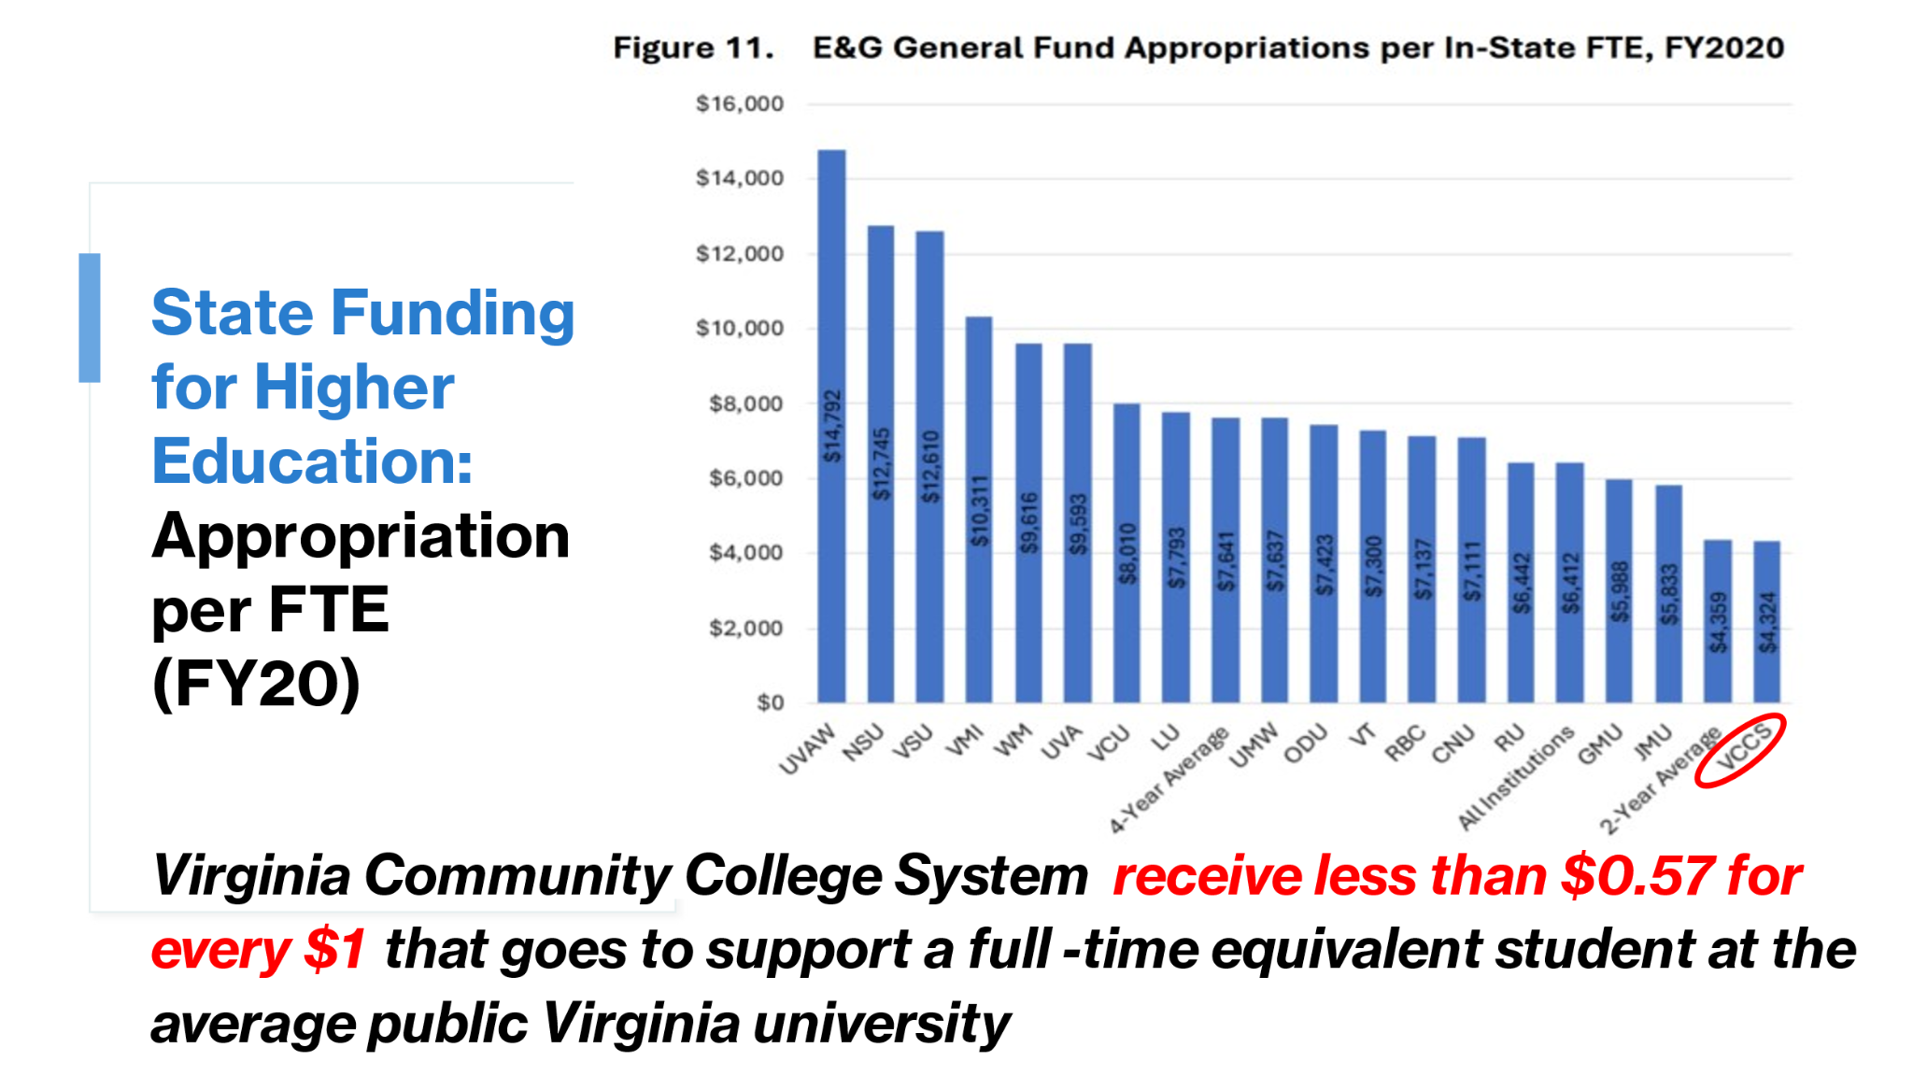

Slide 18
INCREASE
REGIONAL CAPACITY
SOLUTIONS
The VCCS must scale up workforce training offerings to increase the workforce talent pipeline in high-demand sectors , concentrating on working adults and high school students
Renovate and re-equip state-of-the-art career and technical programs and labs
Hire additional credentialed faculty
Focus not just on completion, but also on job placement

Slide 19
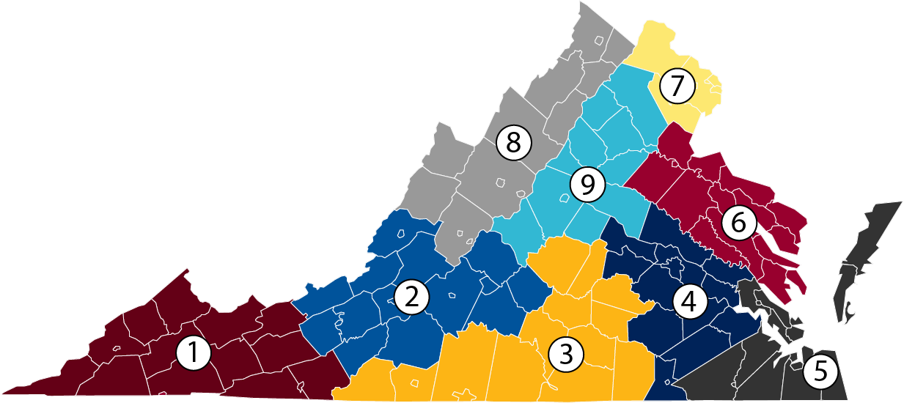
Source: GOVIRGINIA.ORG

Slide 20
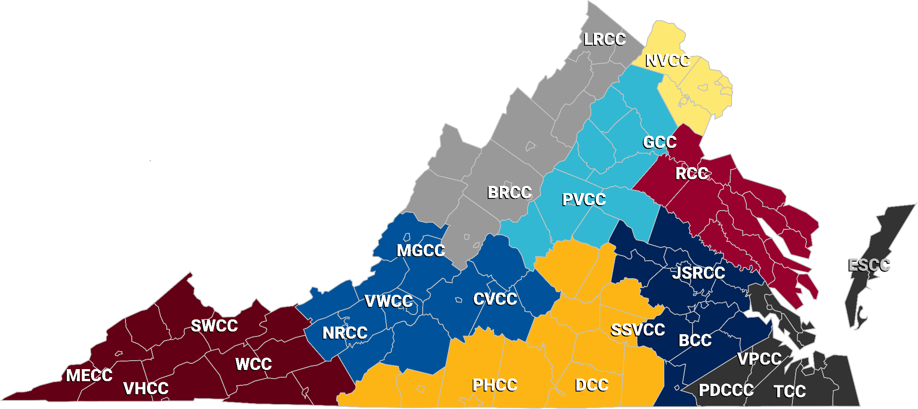
VCCS
COLLEGES:
By GO Virginia Regions
Source: GOVIRGINIA.ORG

Slide 21
INCREASE WORKFORCE TALENT PIPELINE FOR
IN-DEMAND JOBS IN HIGH-DEMAND SECTORS
SOLUTIONS
Increase dual enrollment opportunities leading to a bachelor’s degree program or a high-demand credential leading to gainful employment
More comprehensive outreach to high school students and guidance staff about community college paths to success
Additional resources!!

Slide 22
QUESTIONS?
THANK YOU FOR YOUR PARTNERSHIP!! WE APPRECIATE IT!!
edavenport@vccs.edu
(804) 819-4969
www.vccs.edu

